Slide 1
Caramel Chemistry: exploring phase transitions and polymerization
Arwyn L. E. Smalley, Ph. D.
Saint Martin’s University
Lacey, WA
Notes:
The purpose of laboratory activities is to illustrate concepts from class. Why not use food, which has extremely interesting and complex chemistry, to motivate students to be interested? This is especially important in non-majors chemistry courses, where students may not be interested in chemistry for its own sake.

Slide 2
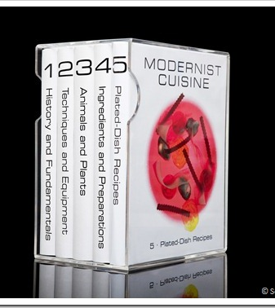
Using food chemistry
Popular
Context
Application
Fun
Learning
Notes:
This activity originated from a course that I taught my first year at SMU – “Chemistry in the Kitchen” – a special topics course that I haven’t had the time to teach ever since, but as part of this course I developed a lot of labs. When I first got started I didn’t know very much (as is often the case with a new course) – but I had some ideas. Some of the resources that I found:

Slide 3
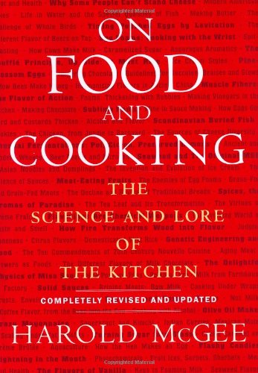
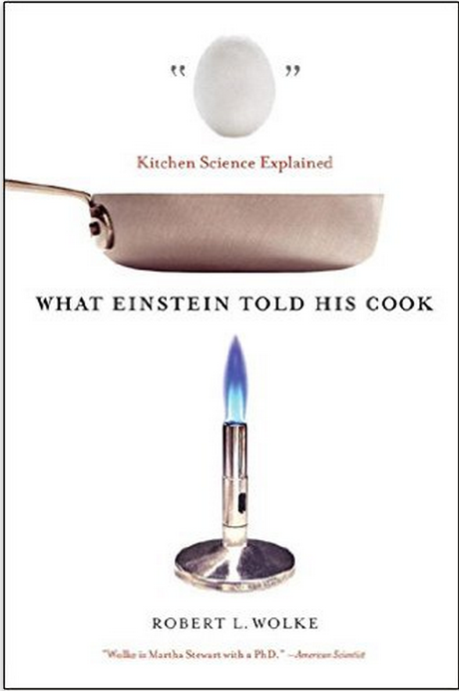
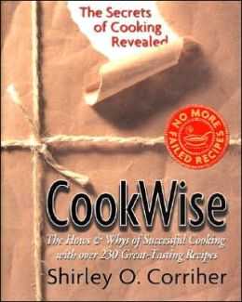
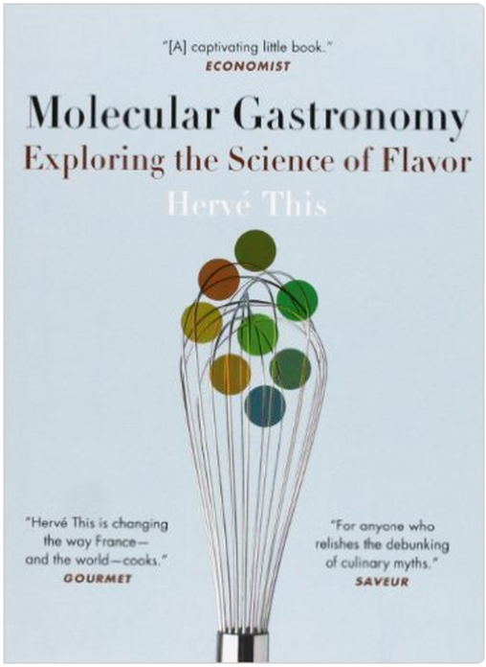
Starting resources

Slide 4
A few food lab concepts…
Measurement
Cheese making
  Acid precipitation
  Enzymes/bacterial
Leavening
  Acid-base
  Yeast
Solvent extraction
Sourdough
Gels
Polymerization
Browning reactions
Chocolate
  Crystal structures of fats
  Tempering
Notes:
It’s possible to explore a lot of different chemistry concepts through the lens of food. Chocolate is fun, but since most of us don’t have the resources to do the whole process of fermenting and then roasting the beans, grinding, conching, and so on – all we can really do is tempering, which is a phase change exploration. So instead, we look at caramel as a “sweet” chemistry activity.

Slide 5
Caramel recipe*
2 C white sugar
1 C light brown sugar, packed
1 C light corn syrup
1 C heavy whipping cream
1 C half and half
1 C butter (I used salted butter)
4 tsp vanilla extract
Heat to 248 °F
*Source: “Sandi’s Famous Caramels”, from Baby Catcher, by Peggy Vincent
Notes:
Recipe: “Sandi’s Famous Caramels”
From Baby Catcher, by Peggy Vincent

Slide 6
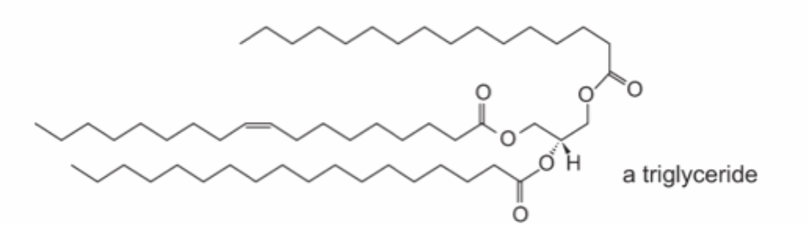
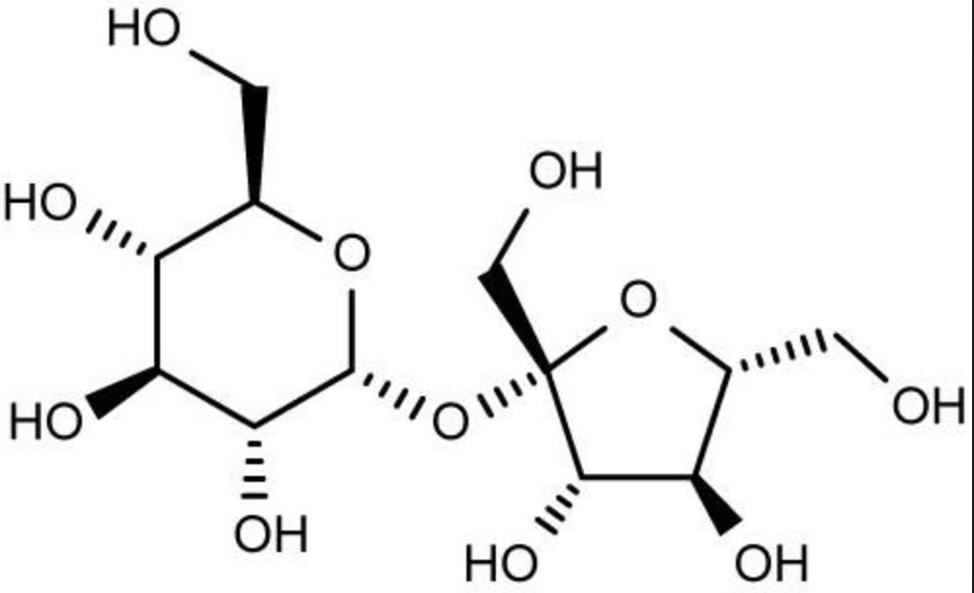
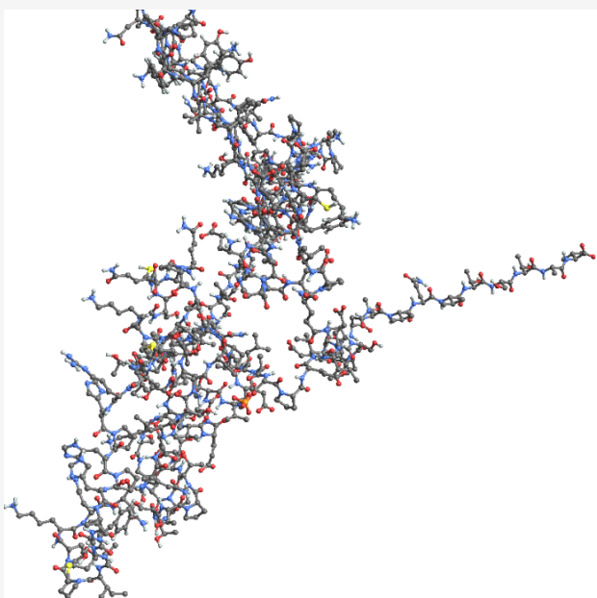
Macronutrients
Lipids (butter)
Carbohydrates (sugar)
Protein (milk and cream)
(Water)

Slide 7
Phases, phase change
Phases:
  Solids (sugar, fat)
  Liquids / colloids (milk and cream)
Physical changes:
Melting of fats
Dissolving sugar
Vaporization of water

Slide 8
“Caramelization” – chemical reactions
Polymerization and Maillard reactions
Tasty flavors
Thickening
(Usually) pleasant
odors
Nonenzymatic
browning
Condensation
Complex

Slide 9
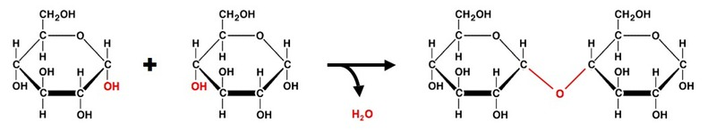
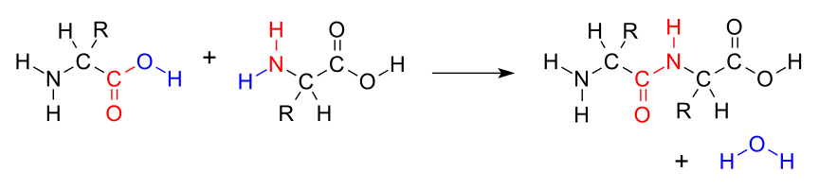
Familiar condensation reactions
c

Slide 10
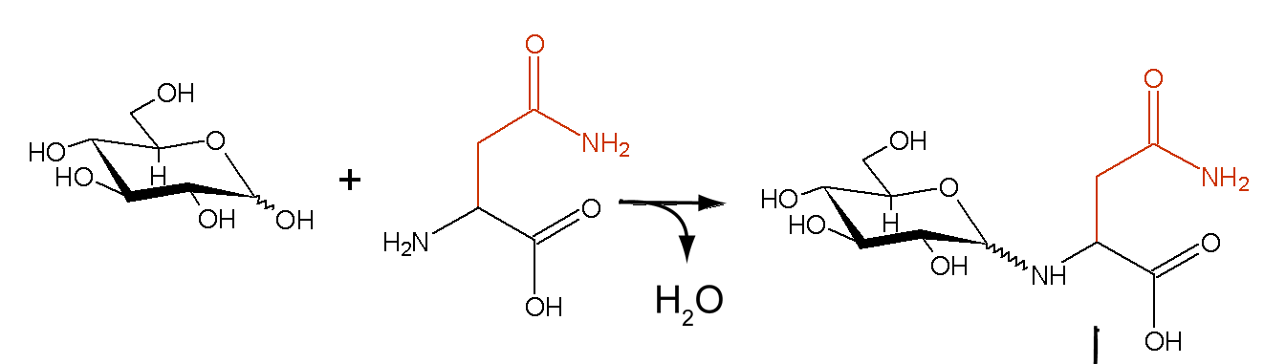
Basic Maillard reaction

Slide 11
When making caramel:
Time:
30-45 minutes of cooking (1-1.5 hours activity/lab time overall)
Also…
Notes:
I ran two sets of lab students through the activity during a 2.5 hour lab period – including clean-up time.

Slide 12
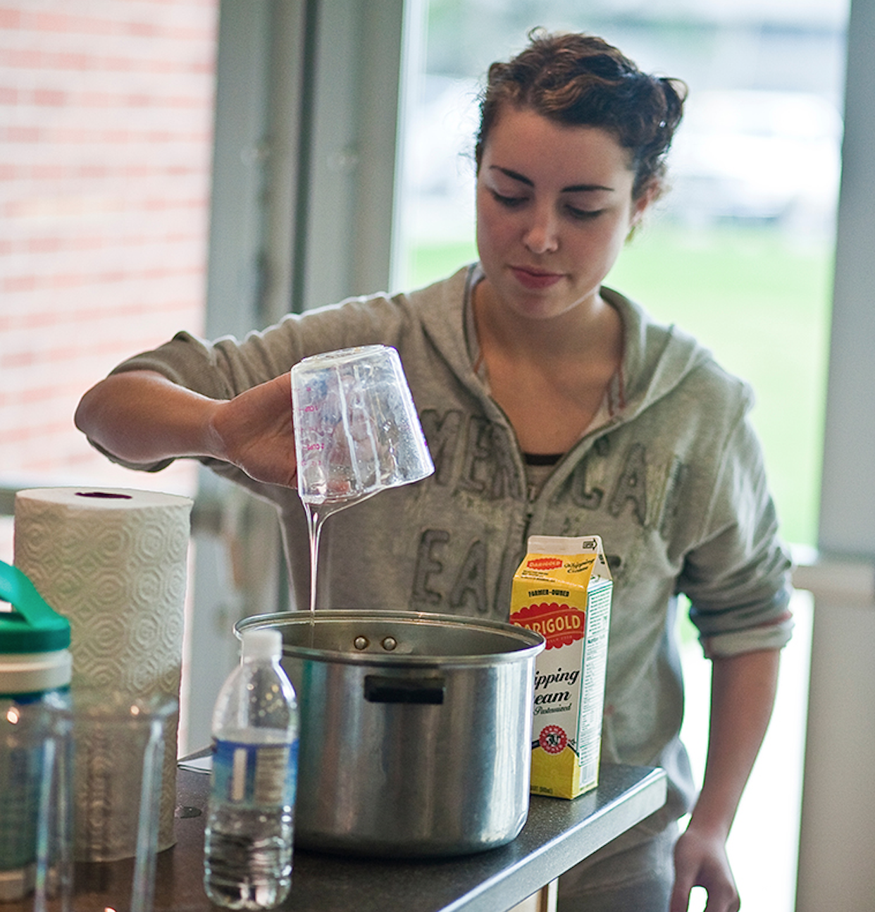
It’s messy…

Slide 13
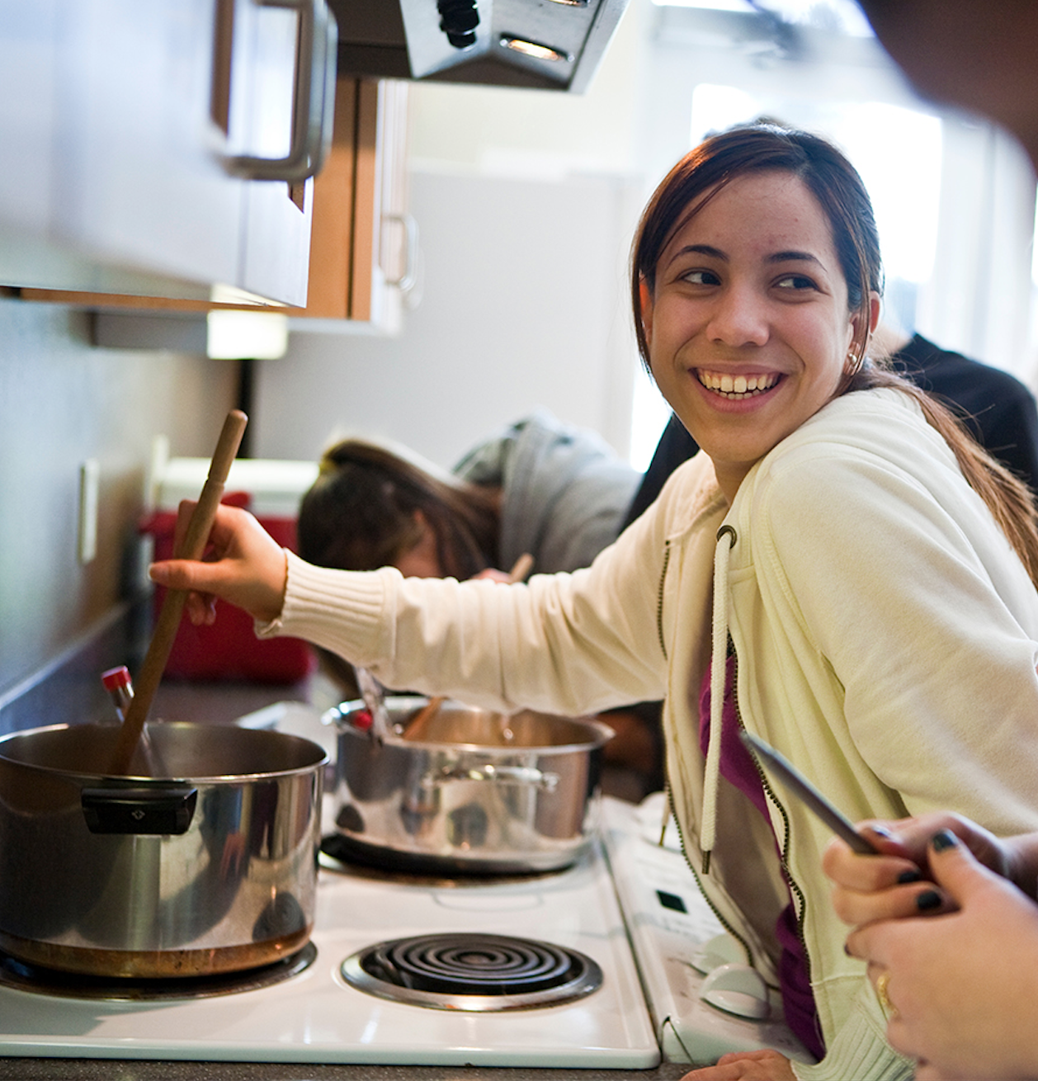
Requires constant stirring...

Slide 14
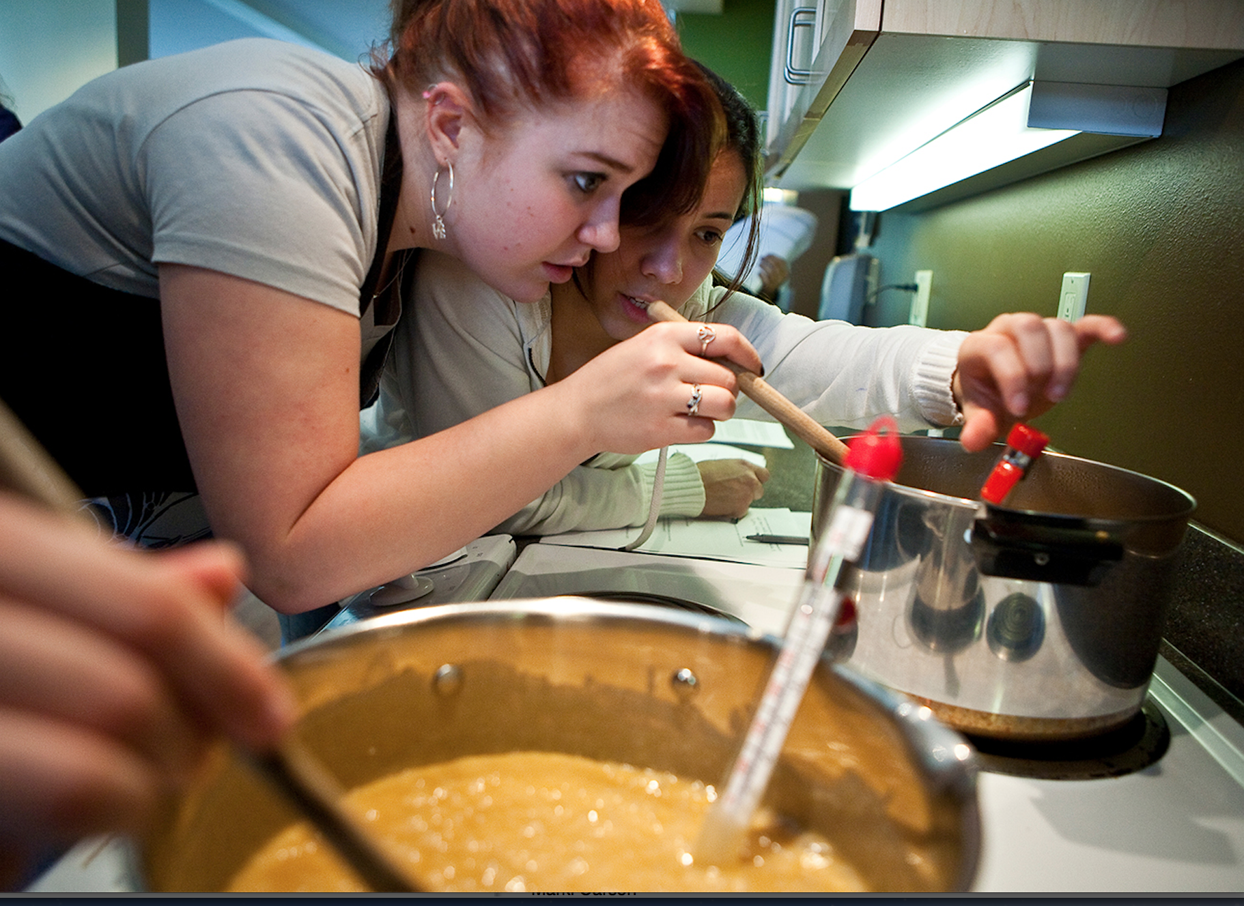
Pay close attention to the temperature…

Slide 15
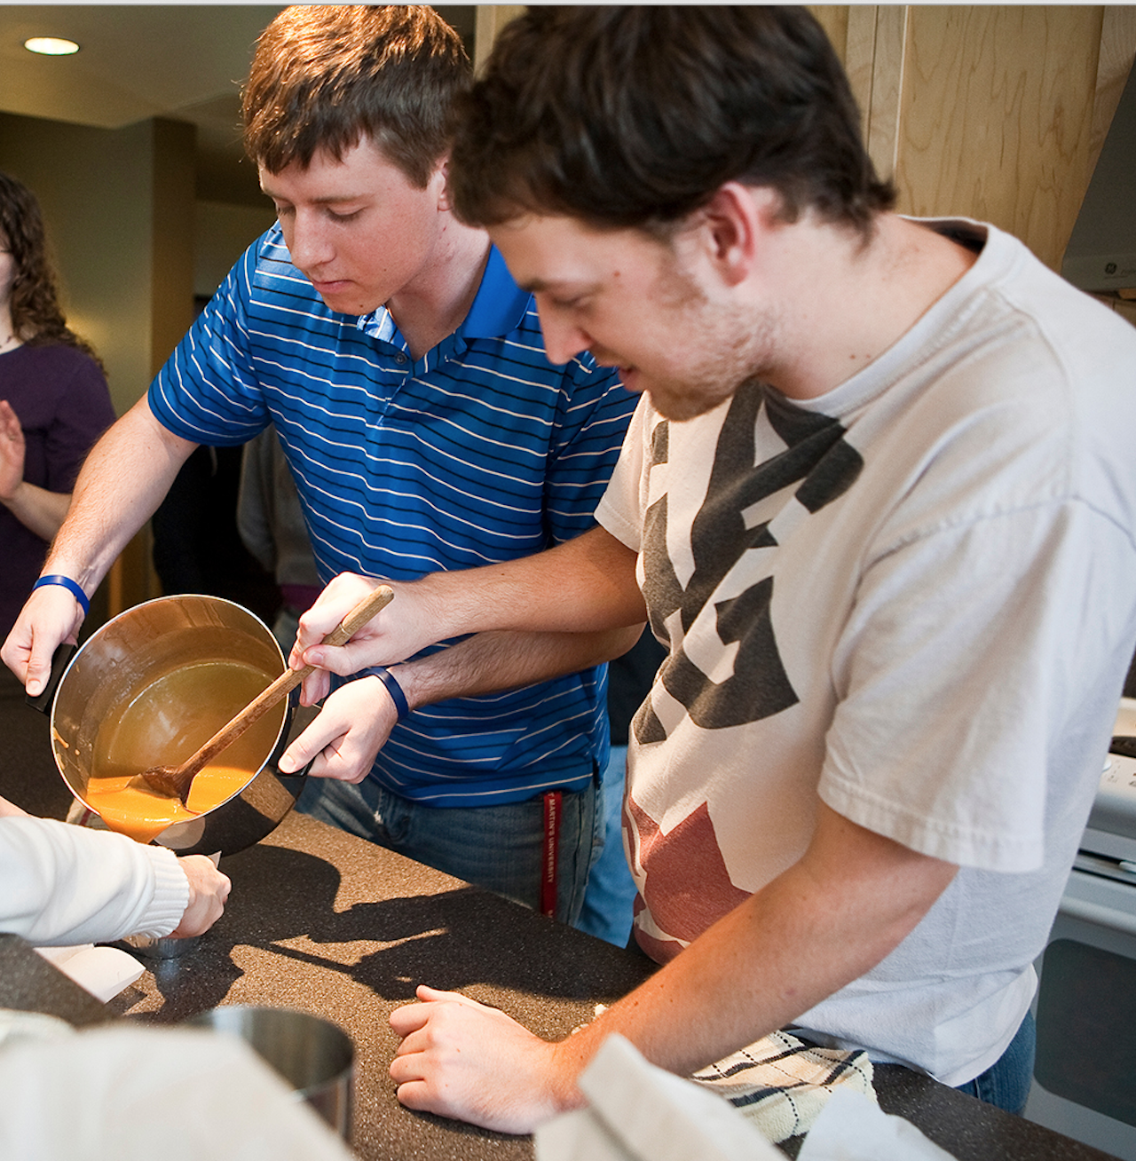
It’ll be very hot – be careful!

Slide 16
Samples will take time to cool (so have some already made if you’re demo-ing)

Slide 17
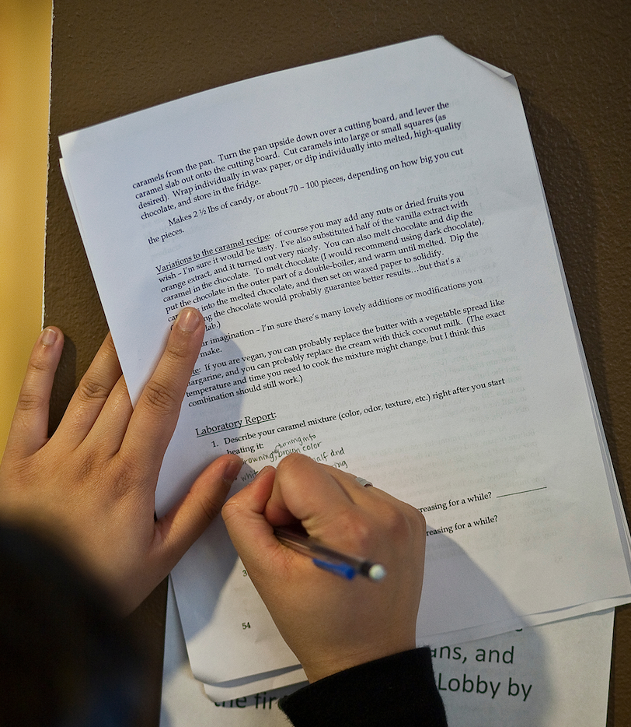
As a lab…
Drawing chemical structures
Drawing chemical reactions
Identifying functional groups
Other observations
Notes:
You can make this part more or less challenging depending on your students – I taught this most often as part of my non-majors chemistry class, but I still made them draw chemical reactions and structures, and answer questions about their observations and suppositions.

Slide 18
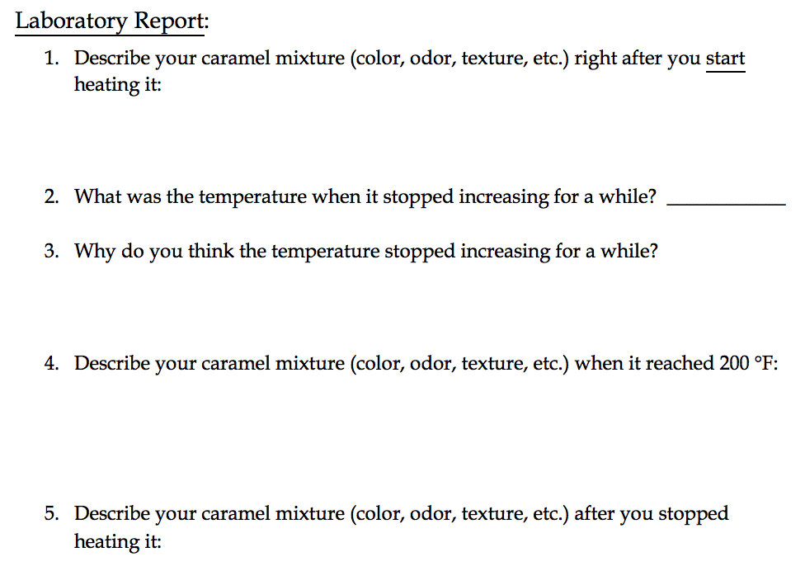

Slide 19
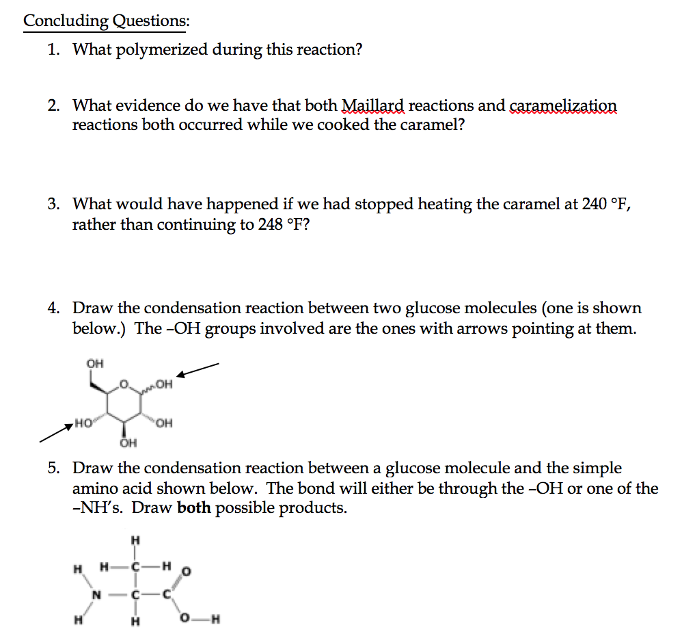

Slide 20
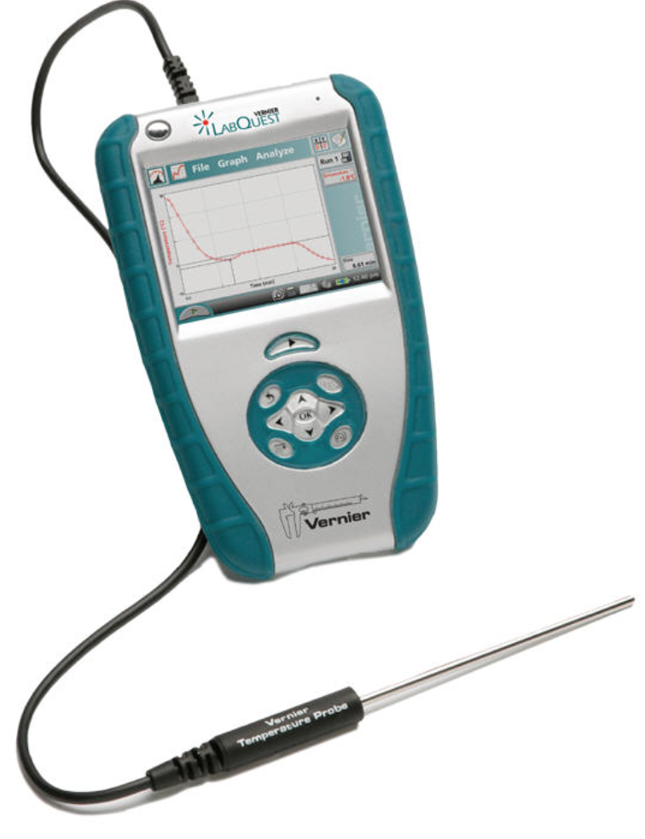
Future improvements…
Track temperature more accurately
Graph temperature: phase transition

Slide 21

Acknowledgements
My “Chemistry in the Kitchen” students (S ‘09)
Justin Rewerts (‘14)
My nonmajors chemistry students
Saint Martin’s University
Faculty Development Committee

