Slide 1
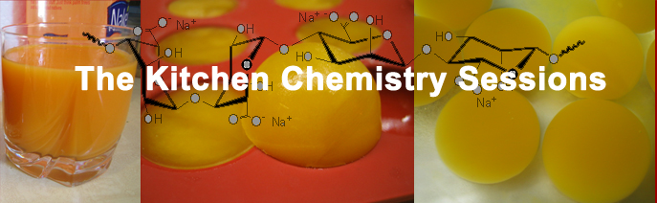

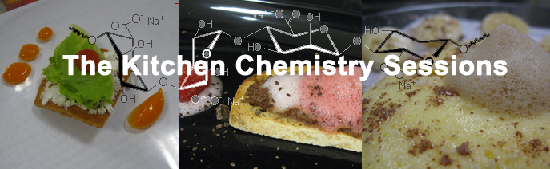
:
Molecular Cuisine to Make
Science Palatable
Subha R. Das
Dept. of Chemistry
24th Annual Conference for the Washington College Chemistry Teachers Association
Leavenworth, WA
October 14, 2016

Slide 2
09-109 for First Years and Non-Science Majors
Subha R. Das
Dept. of Chemistry
09-209 For students who have had Organic Chemistry
(Chem Majors +)

Slide 3
The Kitchen Chemistry Sessions
Why
(Some)What (+ how)
So
Challenges

Slide 4
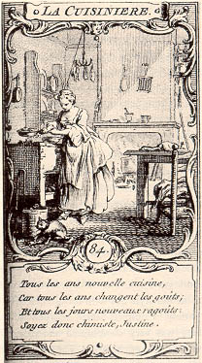
Cooking and Chemistry
New cooking every year,
Because every year tastes change;
And every day there are new ragouts;
And so you must be a chemist, Justine.
La Cuisinere, 1759
Hubert Francois Gravelot
The discovery of a new dish does more for human happiness than the discovery of a new star"
- Anthelme Brillat-Savarin
French Gastronome & lawyer
(1755 - 1826) - Physiologie du Gout, 1825

Slide 5
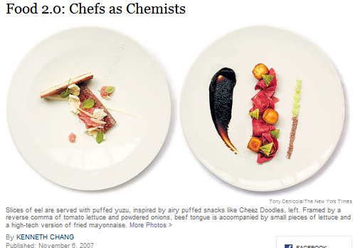
Molecular Gastronomy or Molecular Cuisine (previously)
or Modernist Cuisine (current)

Slide 6
What is Molecular Gastronomy?
Webster’s New Millennium dictionary definition:
The application or study of scientific principles and practices in cooking and food preparation
(Food Science?)
Wikipedia:
Molecular gastronomy is a subdiscipline of food science that seeks to investigate, explain and make practical use of the physical and chemical transformations of ingredients that occur while cooking,..
…name of the scientific discipline co-created by Kurti and This to be based on exploring the science behind traditional cooking methods." [1992]
Have you ever wondered if these time-honored techniques work? Why do they or don't they work? Is there a physical or chemical basis for what's happening to the food as it cooks?

Slide 7
Molecular Gastronomy or Molecular Cuisine (previously)
or Modernist Cuisine (current)

Slide 8
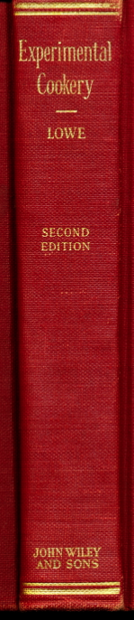
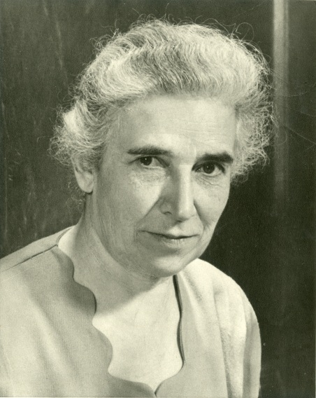
An almost overlooked early pioneer
Professor of Food and Nutrition at Iowa State College,
Published Experimental Cookery: From The Chemical And Physical Standpoint which became a standard textbook for home economics courses across the United States. The book is an exhaustively researched look into the science of everyday cooking referencing hundreds of sources and including many experiments"
(Wikipedia entry on Molecular Gastronomy)
Belle Lowe (1886–1961)
Thanks Anne Glenn (Guilford College)

Slide 9
What is Molecular Gastronomy?
…Understanding the science of cooking could lead to amazing culinary creations, chefs and foodies began to salivate. Today, several renowned chefs have embraced molecular gastronomy to concoct seemingly bizarre dishes that are shockingly delicious.
How Molecular Gastronomy Works
by William Harris
http://science.howstuffworks.com/innovation/edible-innovations/molecular-gastronomy.htm

Slide 10
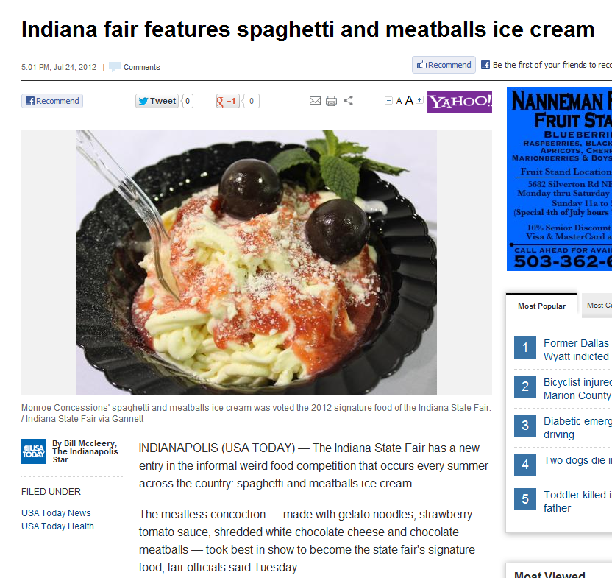
The creation does not actually mix meatballs with ice cream. Rather, it is made with gelato noodles, strawberry tomato sauce, shredded white chocolate cheese and “chocolate meatballs,” according to Indiana State Fair officials.
"…was voted the 2012 signature food of the Indiana State Fair."
Indianapolis Star/USA Today - July 24, 2012

Slide 11
Why
Food and cuisine represent a multi-sensory, universal, cross-cultural, high impact delivery vehicle
to make science, particularly chemistry
more palatable
to a wide audience
in an engaging (multi-sensory) way
Molecular gastronomy/cuisine has especially
high (sensory) impact

Slide 12
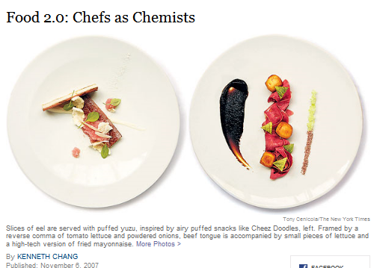
Molecular Gastronomy or Molecular Cuisine
How about doing this in reverse?

Slide 13
Teaching Chemistry
through food, molecular gastronomy/cuisine
Students are motivated to learn when they see the usefulness and relevance of what they are learning,
Students explore real data (improves learning) with hands on activities
A single-context ("Molecular Cooking"), can enhance learning by reducing extraneous cognitive load - students can focus on the important scientific principles and transformations explored in demonstrations and labs.
For science students - this can reinforce, re-organize, and extend students’ knowledge of chemistry and biochemistry.

Slide 14
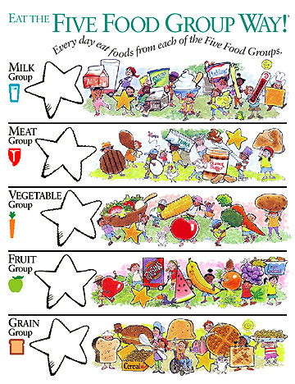
Course format
food molecule groups:
Water
Fats/Lipids
Carbohydrates
Proteins
Aroma/flavor molecules
(Final Projects)
http://www.nutritionexplorations.org/images/catalog/books/elementary/5FoodWay_front_big.jpg

Slide 15
The Kitchen Chemistry Sessions
format – lecture/demo/lab
7 Sessions – based on important food molecule groups:
Water
Fats/Lipids
Carbohydrates x2
Proteins
Aroma/flavor molecules (+taste receptors and perception)
Final Dishes:
The students have to
1. create dishes (using 1+ of each food molecule group)
2. Explain the science behind them
3. decipher how the other student (groups) created dishes.
Underlying concepts adaptable to other frameworks, contexts

Slide 16
Course format
We will meet once a week to go over concepts, observe demonstrations, and give you an opportunity to practice running experiments in a laboratory group. Each student will learn how to keep a lab notebook and write-up their experiments in a scientific manner. Because the main activities in this course will occur in class, attendance is critical to your learning the material and developing the necessary skills. Outside of class you will also be expected to do readings, assignments and write up reports, individually.

Slide 17
Lab Protocol = Recipe
Miles, DT, Bachman, JK, J Chem Ed 2009, 86, 311

Slide 18
What can we expect of students
Students should be able to:
  • Identify the key chemical features and characteristics of basic food ingredients and explain how these properties affect and determine their handling, use, (and taste)
  • Analyze and compare ingredients, recipes and protocols and be able to predict the purpose of and test the effectiveness of ingredients in recipes and dishes
  Exemplify the scientific process and inquiry driven research by designing, implementing, and documenting experiments (edible or otherwise)
  (Working in groups)
  Use scientific principles to produce dishes using novel techniques and explain how they were constructed

Slide 19
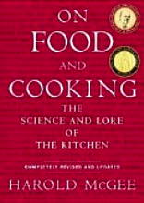
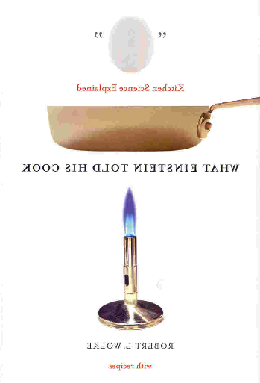
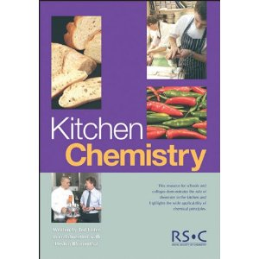
Useful references
Barham, P. (2000). The Science of Cooking. Berlin, Springer-Verlag.
McGee, H. (2004). On Food and Cooking: The Science and Lore of the Kitchen. New York, Scribner
ISBN-13: 978-0684800011
Wolke, R. L. (2002). What Einstein Told His Cook. New York, W. W. Norton & Company
ISBN-13: 978-0393329421
Ted Lister & Heston Blumental (2005) - Kitchen Chemistry RSC
---
See also:
The Science of Cooking (2016) – J. Provost, K. Colabroy, B. Kelly, M. Wallert (Wiley)
Why Does Asparagus Make Your Pee Smell?: Fascinating Food Trivia Explained with Science (2016) - by Andy Brunning
https://www.amazon.com/Does-Asparagus-Make-Your-Smell/dp/1612435513/

Slide 20
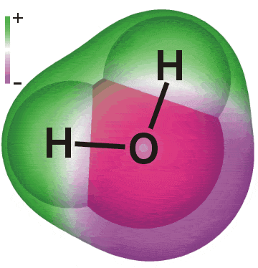
1. WATER
Water
Concepts:
Polarity,
hydrogen bonding
http://www1.lsbu.ac.uk/water/molecule.html (Martin Chaplin)

Slide 21
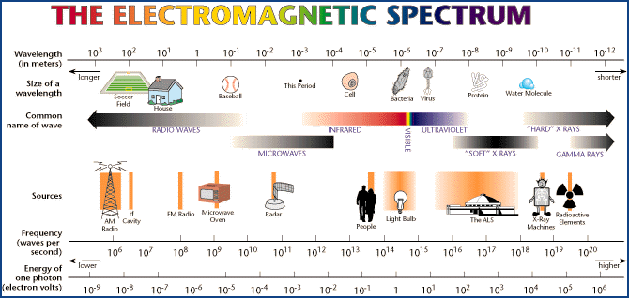
http://www.electro-optical.com/html/bb_rad/emspect.asp
How does a microwave oven work?

Slide 22
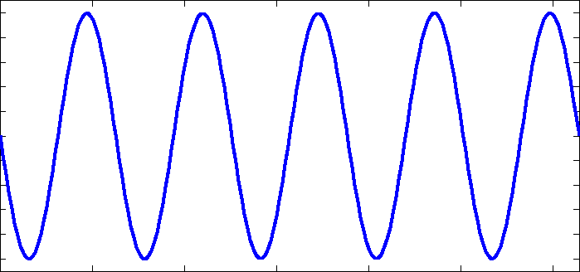
-
+
2450 MHz
(2.45 GHz)
Notes:
22

Slide 23
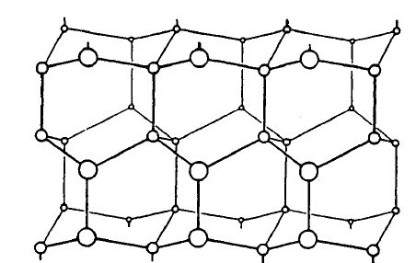
Microwave will not heat ice, but water will boil
2450 MHz
(2.45 GHz)

Slide 24
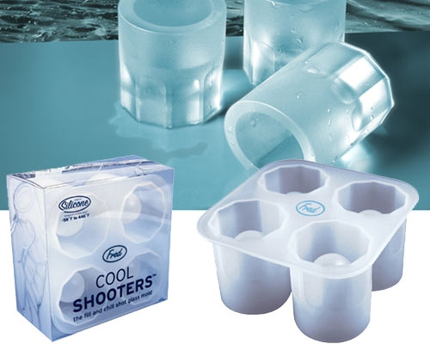
O=C=O
Non-polar
Microwave will heat Coke, without losing fizz
(no nucleation as on
stovetop)
Microwave will not heat ice, but water will boil

Slide 25
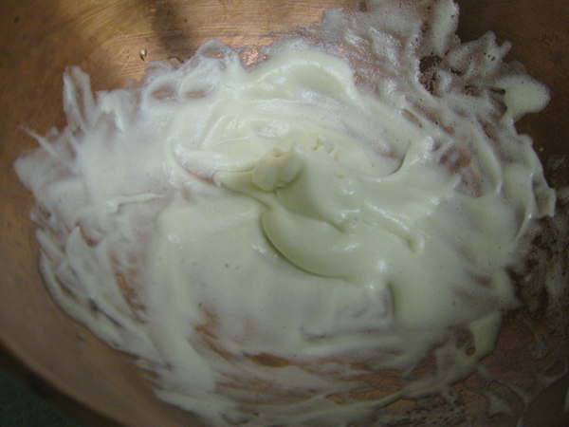
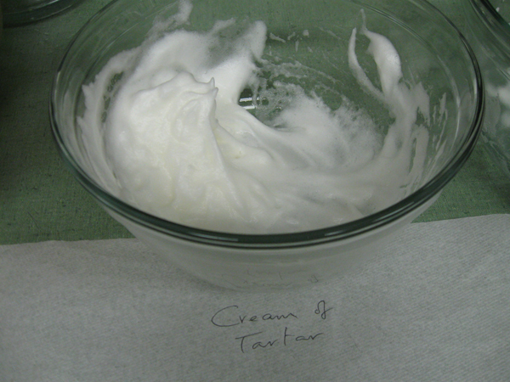
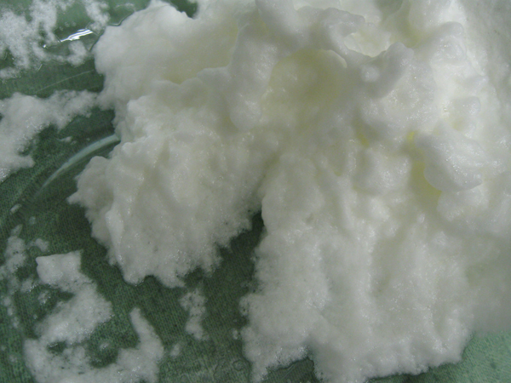
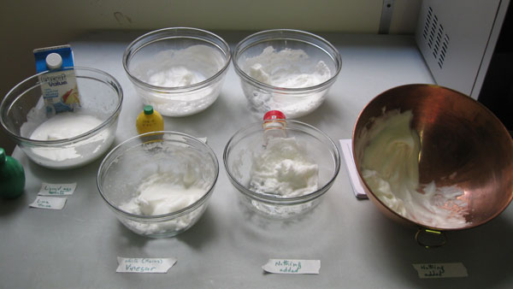
Whipping egg whites, beat (stabilized), flavor & cooked in a microwave
Denaturation -

Slide 26
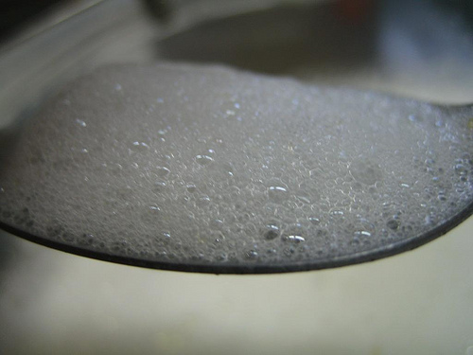
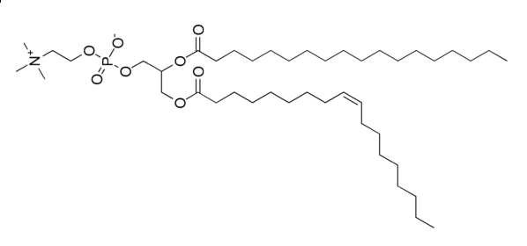
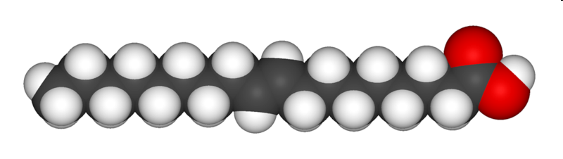
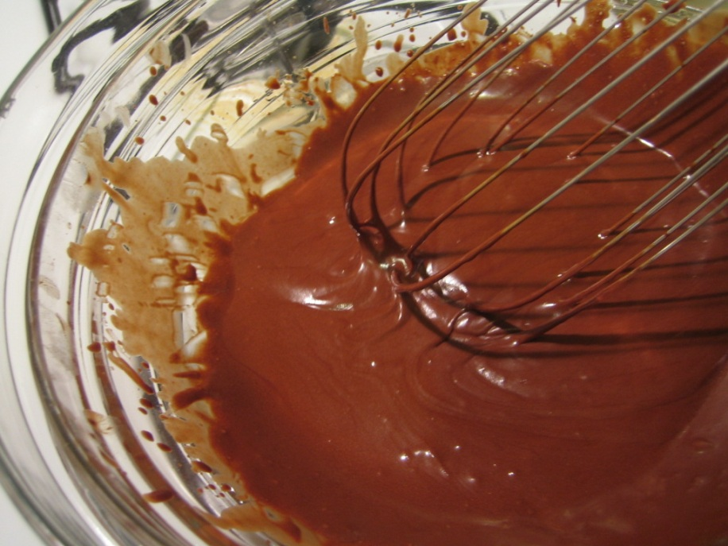
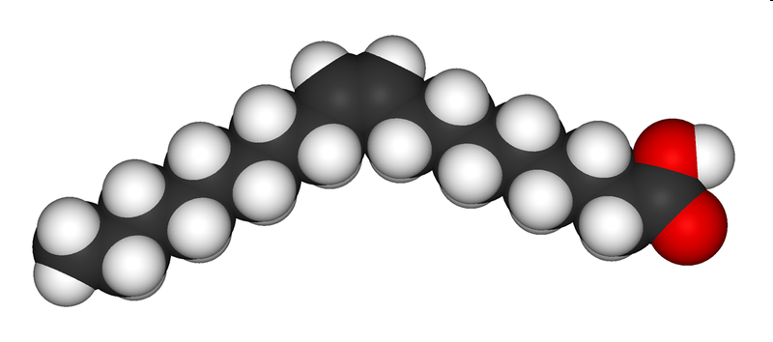
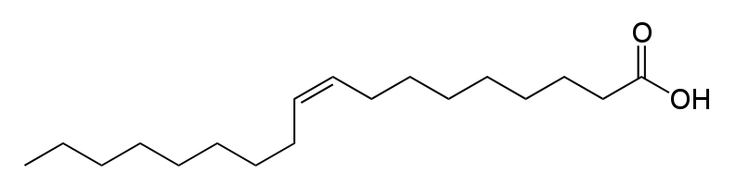
Lipids and Emulsifiers

Slide 27
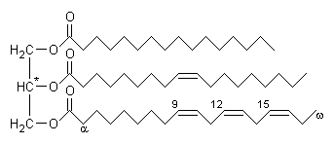
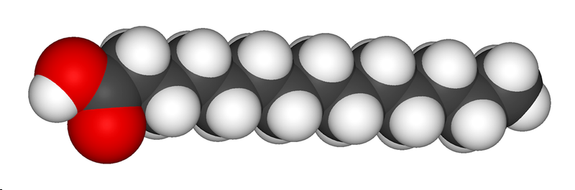
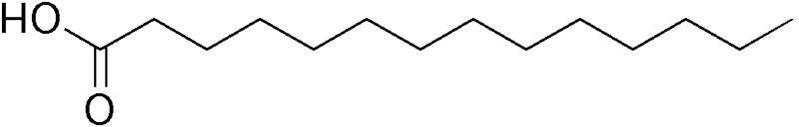
Triglycerides are three fatty acids joined to a molecule of glycerol (a tri-alcohol)
R- = CH₃- , CH₃-CH₂- , CH₃-CH₂-CH₂- etc.
(remember: C can have 4 bonds, so the end group will be CH₃)
water
alcohol
glycerol
Carboxylic acid (COOH)
Fatty acid

Slide 28
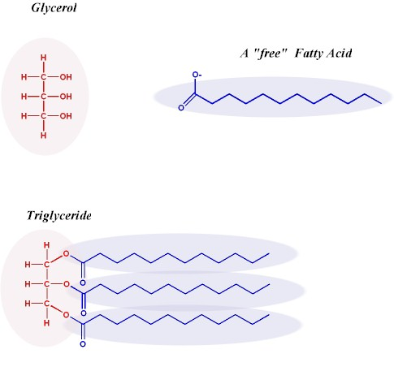
Triglycerides: Fatty Acids and Glycerol
95 percent of dietary fat and stored fat
Triglyceride = Glycerol + 3 fatty acids
http://www.oliveoilsource.com/olivechemistry.htm

Slide 29


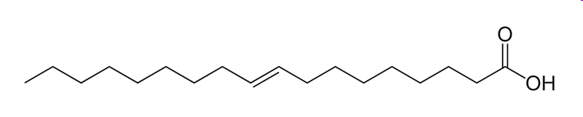
Saturated & Unsaturated (Cis and Trans) Fatty Acids
Oleic acid is a cis unsaturated fatty acid that comprises 55–80% of olive oil.
Cis = on the same side (of the double bond)
These have the same composition
(no. of atoms). They are isomers
Specifically geometric isomers
Elaidic acid is a trans unsaturated fatty acid
Trans = across

Slide 30


α-Linolenic acid: is an ω-3 fatty acid
Linoleic acid
(commonly found in vegetable oil) is an ω-6 fatty acid
ω refers to the position of the double bond from the CH₃ end of the chain
In organic chemistry the acid group would be numbered first and the unsaturations would be at positions 9 and 12 (and 15); the
Linoleic acid CH₃(CH₂)₄CH=CHCH₂CH=CH(CH₂)₇COOH
cis,cis-Δ⁹,Δ¹²
These double bonds can get oxidized (oils go rancid)

Slide 31
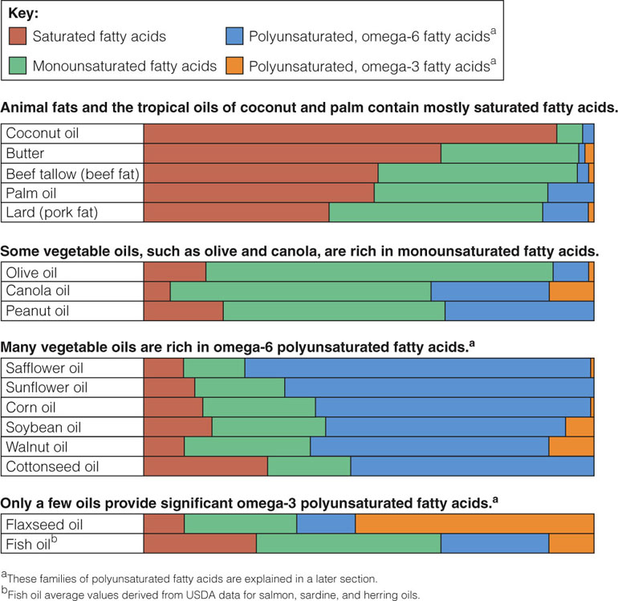
Saturated & Unsaturated Fatty Acids
from Nutrition: Concepts and Controversies by Frances Sizer & Ellie Whitney (Brooks Cole, 2007)

Slide 32
Hydrogenation
Transformation of an unsaturated to a saturated hydrocarbon
Typically this is done with a metal catalyst and a hydrogen source
Typically oils are only partially hydrogenated – thus the cis form
isomerizes to the trans form (more stable) by free rotation about the single bond (not possible in a double bond)

Slide 33
Oil & Water don't mix
Mixing – more 'droplets' cause increase in AREA of interfacial contact - so is unstable
decrease area of contact

Slide 34
Emulsion – stabilized dispersion
A fine dispersion of one liquid in a second, largely immiscible liquid. In foods the liquids are inevitably oil and an aqueous solution.
μm
Water
Oil
Oil-in-water emulsion
Water-in-oil emulsion
Whole milk
Butter
Margarine
Mayonnaise
Vinaigrette dressing

Slide 35

Phospholipids and Sterols
Phospholipid
  Glycerol + two fatty acids + phosphorus
  Phosphorus part makes it soluble in water
  Fatty acids make it soluble in fat
  Therefore can serve as an emulsifier
  Key role is in cell membranes
Phosphatidylcholine
(a component of lecithin)

Slide 36
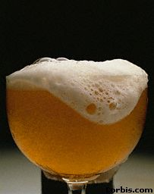
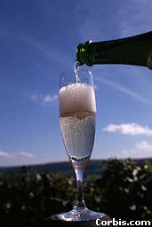
Foams
(air in liquid – similar to emulsions)
Concentrated
Dilute

Slide 37
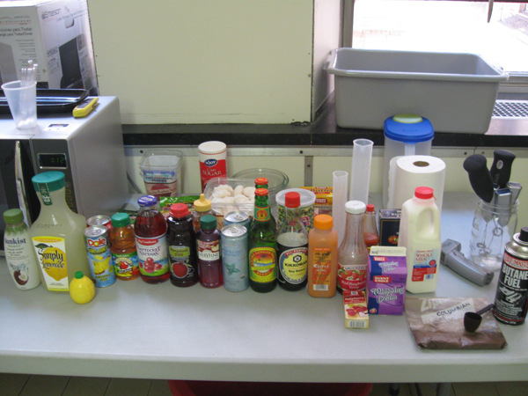
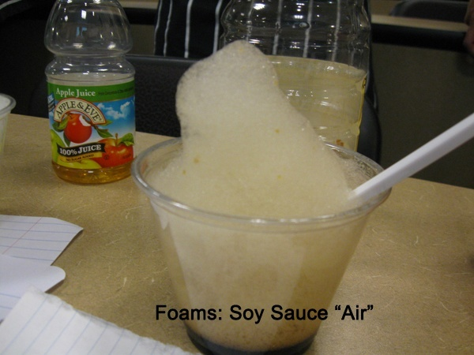
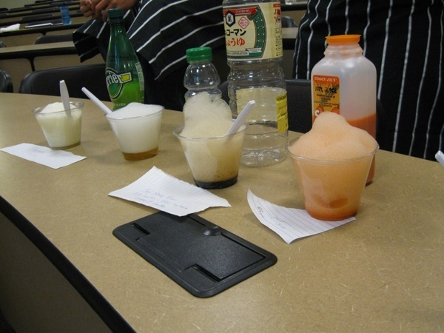
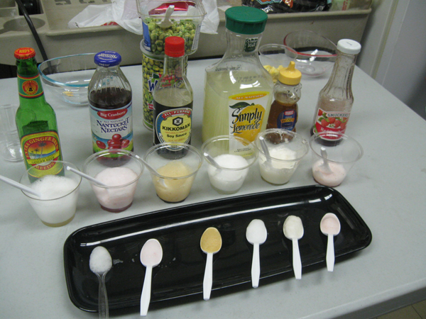
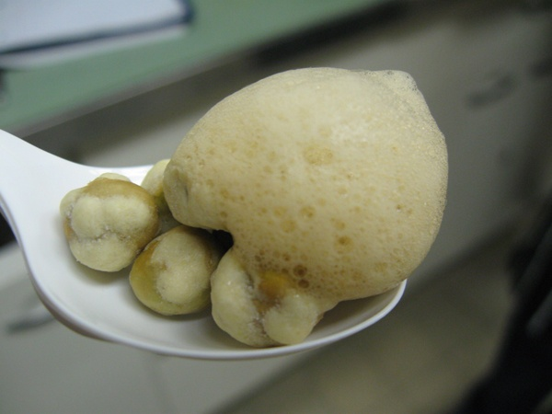
Fun Food with Foams and Emulsions
Use 0.3% to 0.5% (up to 0.8%) lecithin in liquid to create a foam or "air" - air in water emulsion
0.5% is by weight
So for 100 grams of liquid use 0.5 grams lecithin
(TJ’s) Wasabi Peas with Soy Sauce “Air”

Slide 38
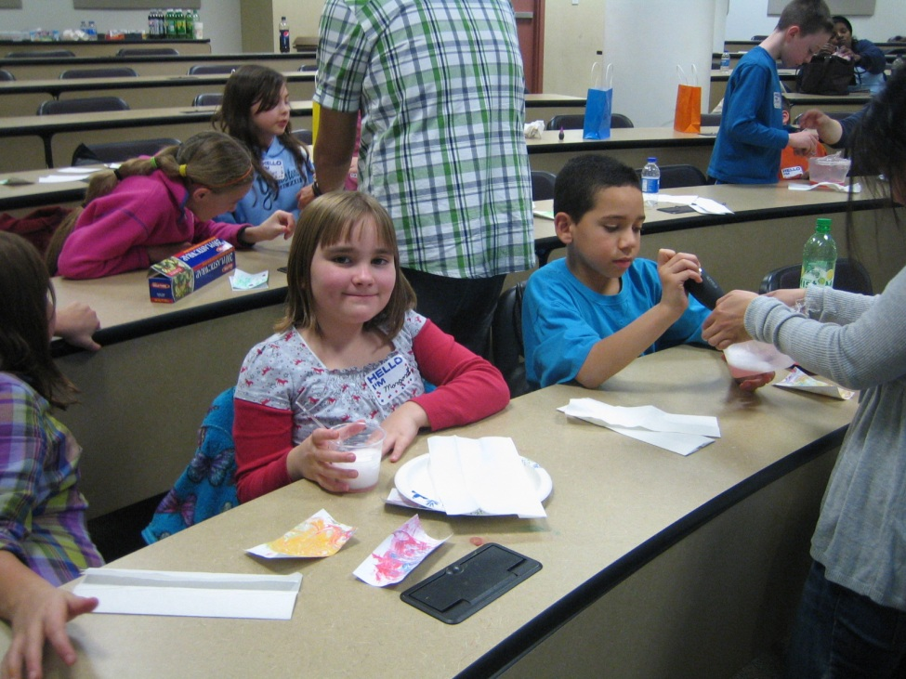
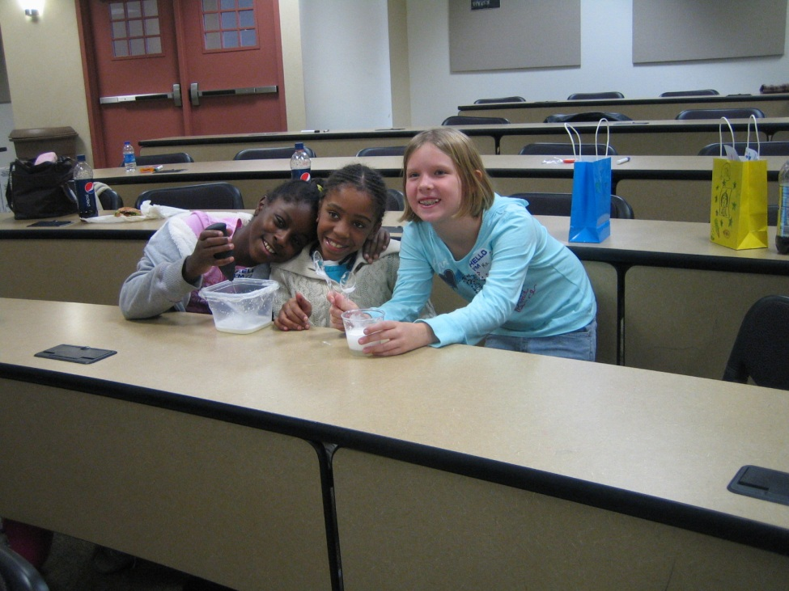
Molecular Cooking Workshops
From High School Students to Fourth Graders

Slide 39
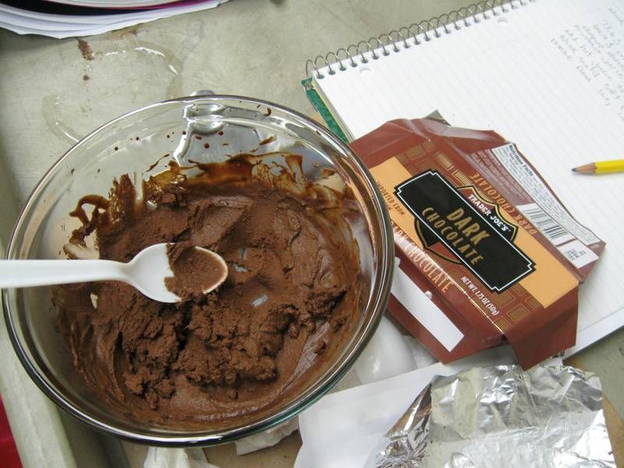
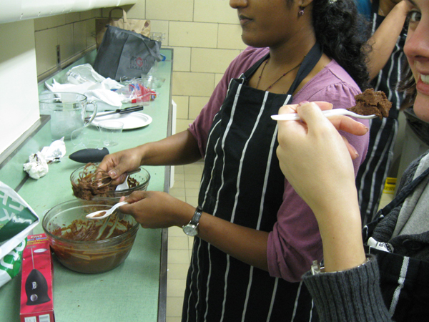
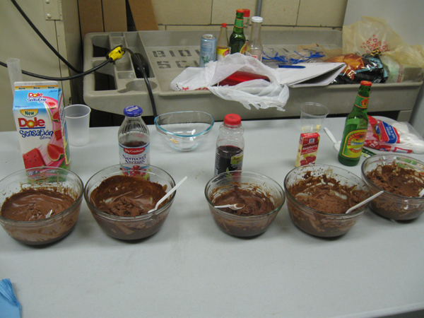
Chantilly [Herve This]
(uses the lecithin in a chocolate bar)

Slide 40
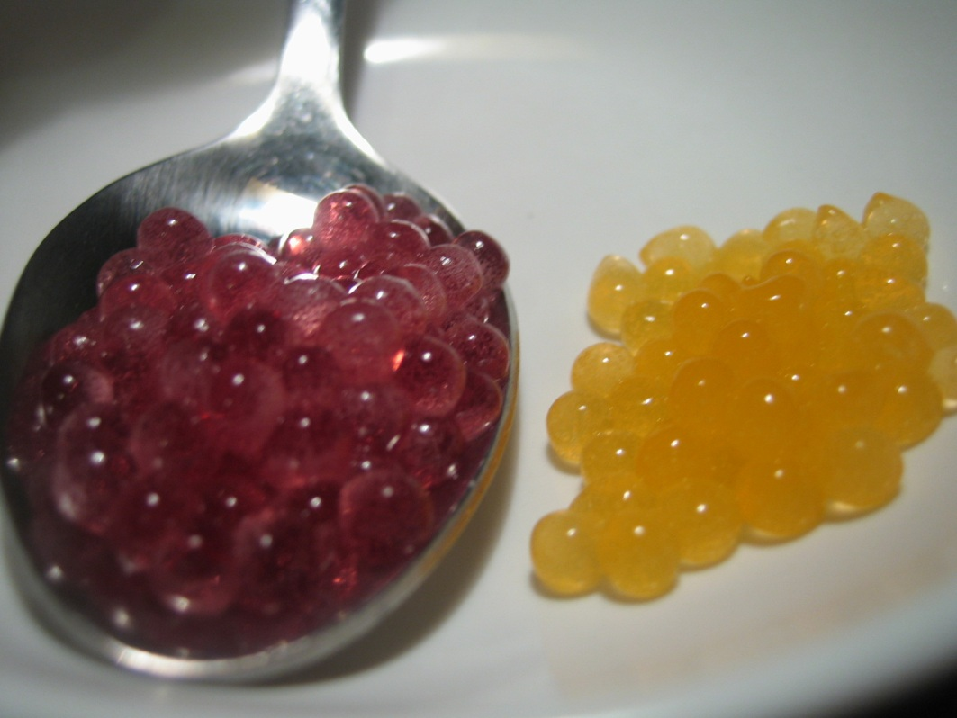
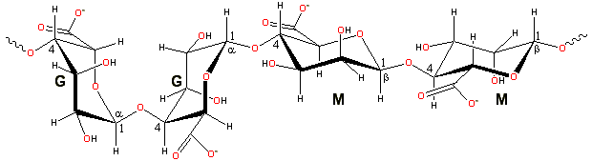
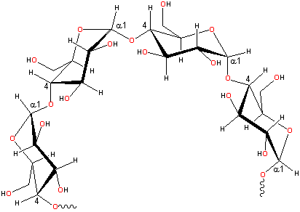
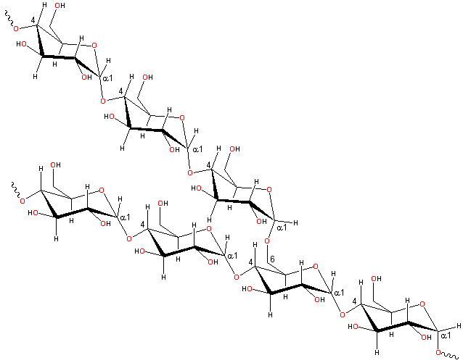
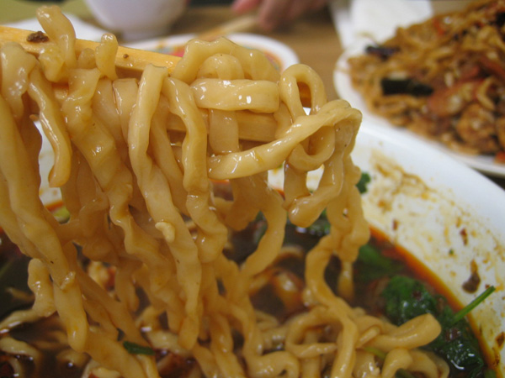

Carbohydrates & hydrocolloids

Slide 41




-OH on C1 is
down
-OH on C1 is
up

Slide 42

Maltose – a 'reducing sugar'
when an -OH group of one monsaccharide reacts with the anomeric carbon of another
= disaccharide
makes an O-glycosidic bond
the ring on the left can no longer
‘open’ to the linear form, said to
be non-reducing.
the ring on the right can open and
is the reducing end. It can convert
between α and β configurations.
Thus, the free anomeric carbon is the
“reducing end”

Slide 43

Example Simple Sugars
Lactose
~5% milk (~50% milk solids). Does not occur elsewhere
Glucose-galactose linked by 1-4 β glycosidic bond.
Galactose opens and closes so REDUCING sugar
Lactase deficiency leads to lactose intolerance. (More resistant than sucrose to acid hydrolysis).

Slide 44
Hydrocolloids
The use of starches (and gums) to impart specific properties to foods
A colloid is a mixture in which one substance is dispersed evenly in another
http://www1.lsbu.ac.uk/water/hydro.html
http://blog.khymos.org/recipe-collection/
http://www.cybercolloids.net/library/search.php

Slide 45


"Cooking" with alginate

Slide 46



"Cooking" with alginate
Sodium alginate
Ca ion
J. S. Nowick et al., The Alginate Demonstration: Polymers, Food Science, and Ion Exchange J. Chem. Ed. 75, 1998, 1430-1431,

Slide 47

"Cooking" with alginate
Image courtesy K. Kirshenbaum

Slide 48


"Cooking" with alginate
In Haute Cuisine
El Bulli, Spain Chef Ferran Adria

Slide 49




Alginate spherification – “caviar”

Slide 50





Alginate spherification – “caviar”

Slide 51




Other carbohydrates
Agar-agar, xanthan gum, carageenan(s), locust bean & guar gums, maltodextrin, ultra-tex (starches)

Slide 52





Carbohydrates (contd.) & Proteins

Slide 53
Types of Browning
Enzymatic
Caramelization
Maillard
(Lipid)
Polymers lead to color – Small molecules to flavor

Slide 54
Maillard Browning
Formation of an N-glucosamine
Amadori Rearrangement
(Formation of diketosamine)
Degradation of Amadori Product
Condensation and polymerization

Slide 55





Maillard Browning
http://blog.khymos.org/2008/09/26/

Slide 56



No Knead Bread
See:
http://www.nytimes.com/2006/11/08/dining/08mini.html?em&ex=1163134800&en=a25918d1aead20f6&ei=5087%0A
http://www.nytimes.com/2006/11/08/dining/081mrex.html?_r=2&oref=s
http://www.nytimes.com/2007/11/21/dining/211brex.html?_r=2&oref=sl

Slide 57


Gluten (bread/wheat protein)
bread is (water in) starch granules in a protein matrix
Bread staling – retrogradation
Images from http://www.kpk.gov.pl/centra_doskonalosci/coe/midi/data/505.html
http://picasaweb.google.com/lh/photo/fCkJPY6D6nI9tiBxkGu-jw

Slide 58


Myoglobin and Hemoglobin
Myoglobin with heme
Hemoglobin with heme
(tetramer - Allosteric binding of Oxygen)
Why is dark meat dark? Answer myoglobin for fast-twitch muscles that are in active parts
http://themedicalbiochemistrypage.org/hemoglobin-myoglobin.html

Slide 59




Myoglobin Heme
In vegetables
O₂, CO₂, CO, NO
Chlorophyll
http://www.amazingribs.com/tips_and_technique/cooking_glossary.html
http://www.popsci.com/diy/article/2009-01/shades-green

Slide 60

http://www.amazingribs.com/tips_and_technique/cooking_glossary.html

Slide 62



Other topics/items in proteins (demos):
Sous vide cooking
Transglutaminase (“meat glue”)

Slide 63

Transglutaminase

Slide 64

Transglutaminase

Slide 65

Transglutaminase

Slide 67

Taste and Flavor Molecules

Slide 68

Taste Receptors
NATURE|Vol 444|16 November 2006|

Slide 69
Encoding of taste qualities at the periphery
NATURE|Vol 444|16 November 2006|

Slide 70





(blind & double blind)

Slide 71
Example Tastes
Sweet (sugar, saccharin)
Sour (acids)
Salt (salt )
Bitter (caffeine, theobromine, quinine)
Umami (monosodium glutamate)

Slide 72



AH/B Model for Sweet compounds
Terry Acree (Cornell)
sucralose
AH – Weak acid, B - electronegative group

Slide 73

Umami
Amino-acid receptor
guanosine
Monosodium glutamate (MSG)
Inosine (mono phosphate)
Hydrolyzed yeast

Slide 75
Course format – lec/demo/lab
Final Dishes
6 Sessions
are based on important
food molecule groups:
Water
Fats/Lipids
Carbohydrates
Proteins
Aroma/flavor molecules
The students have to
1. create dishes
2. Explain the science behind them
3. decipher how the other student (groups) created dishes.
Guidelines for 'dish':
Plate must include at least (but is not limited to):
1. One aqueous liquid (to represent water)
2. One lipid/fat/oil
3. One carbohydrate
(4. OPTIONAL: egg, whey or soy protein)

Slide 76
Finals
Guidelines for 'plate':
Plate must include at least (but is not limited to):
1. One aqueous liquid (to represent water)
2. One lipid/fat/oil
3. One carbohydrate
(4. OPTIONAL: egg, whey or soy protein)
Challenge students to be creative to focus (and assess) their learning.
Can they they use their knowledge in new ways?
50% of grade for creating dish + 50% for figuring out how others made theirs

Slide 77
Final dishes
‘Deconstructed’ BLT

Slide 79




Slide 80




Dessert Sushi: strawberry sheets filled with sweet couscous, chocolate chantilly, caramelized peaches; green tea mousse, crystallized ginger and chocolate syup
http://tinyurl.com/2010FinalDishes

Slide 81




Students get to showcase their knowledge and creativity

Slide 82

Pre- & Post-course Knowledge Assessment

Slide 83

Food provides a context to see 'Chemistry' in good light
Food also provides a good context to connect directly with the public
- Increase public awareness of chemistry and science.
2010 Pittsburgh Post-Gazette

Slide 84





Taste Of Chemistry
exhibition @ the Geek Art Festival 2011 Pittsburgh
tinyurl.com/TasteOfChemistry

Slide 85
In conclusion
Underlying concepts adaptable to other frameworks, contexts
food molecule groups
Water
Fats/Lipids
Carbohydrates
Proteins
Aroma/flavor molecules
A final dish/demo

Slide 86
Acknowledgments
Indira Nair, Amy Burkert
(Vice Provosts for Education),
Dept. of Chemistry
Eberly Center for teaching: Aimee Kane, Marsha Lovett
and most of all…

Slide 87

and most of all… the students
Fall 2013 (109&209)

Slide 88


Questions, comments, suggestions?
srdas@andrew.cmu.edu
The Kitchen Chemistry Sessions
Notes:
88

