Slide 1
Spice-troscopy: A tongue-searing experimental approach to undergraduate instrumental analysis.
Grady Blacken
Rick Glover
Bellevue College

Slide 2
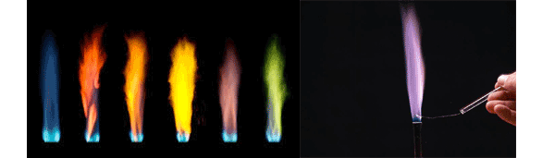
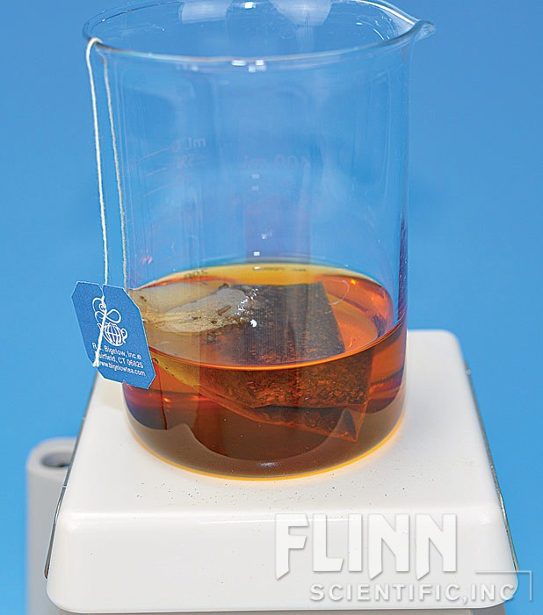
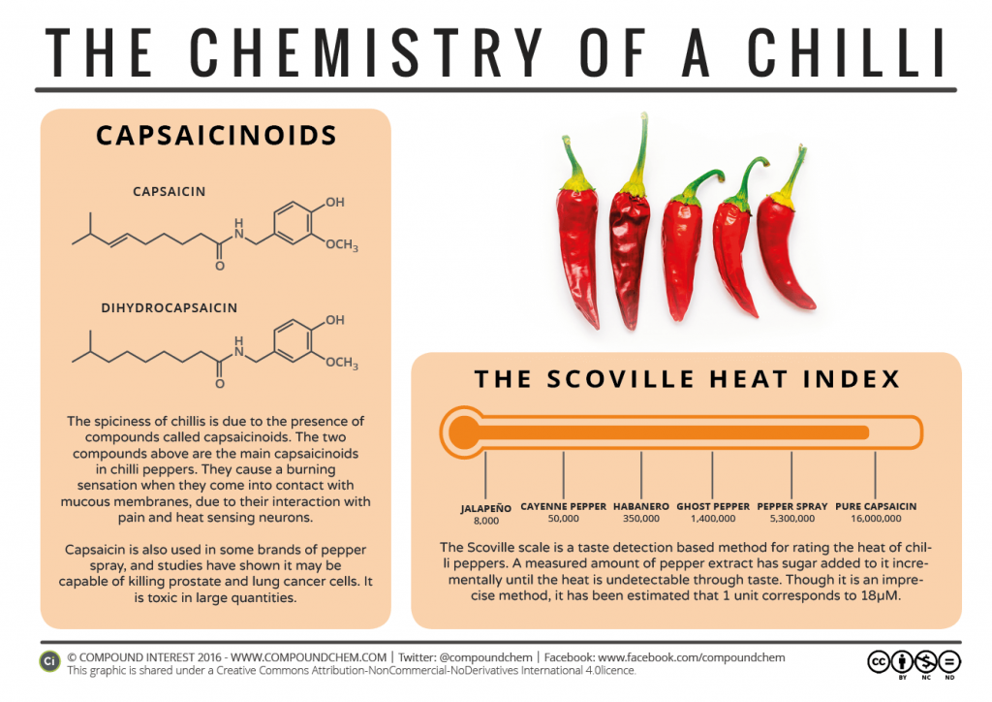
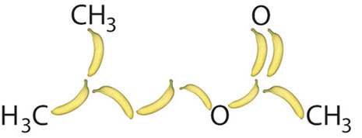
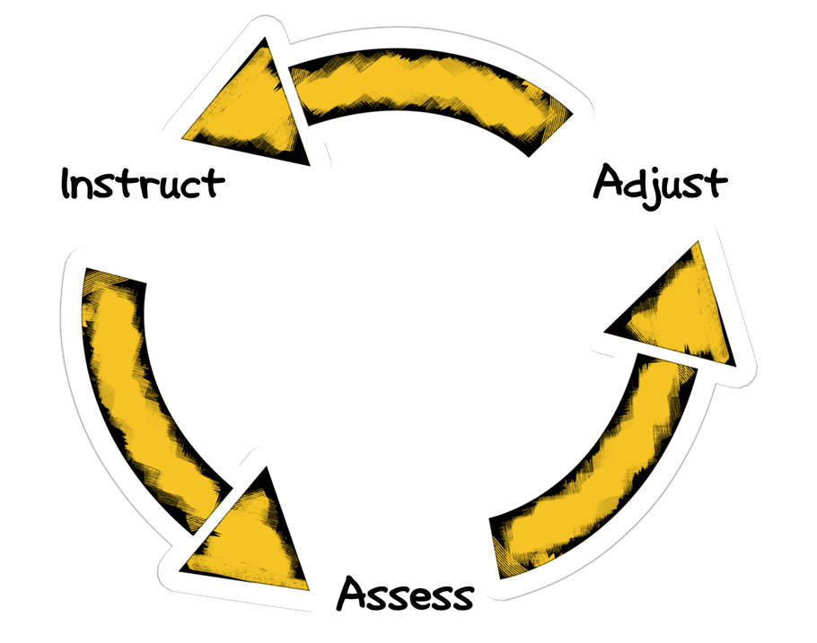
Relating Abstract Concepts to Student Lives
Connecting physical sciences to physical senses.
Differentiating instruction
  Multi-modal: Visual, palatable, kinesthetic
  Incorporate group work and intergroup collaboration
  Assessment strategies: formal/informal assessment
Motivate students toward inquiry

Slide 3
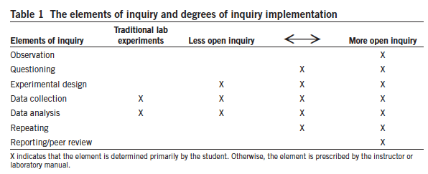
Implementing inquiry
Challenges
Lack of quantitative measures of effectiveness in implementing inquiry into undergraduate education (Beck et al, 2014).
Navigating the challenges of introducing inquiry based labs into science curricula: Student attitudes, instructor workload, funding. (Facayode, 2014)
Stimulate student interest in science careers and retention in upper level science courses. (Kerr and Yan, 2016).
Notes:
Grady

Slide 4
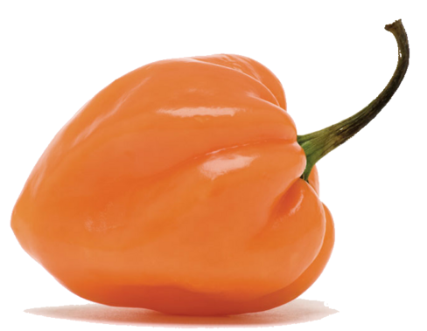
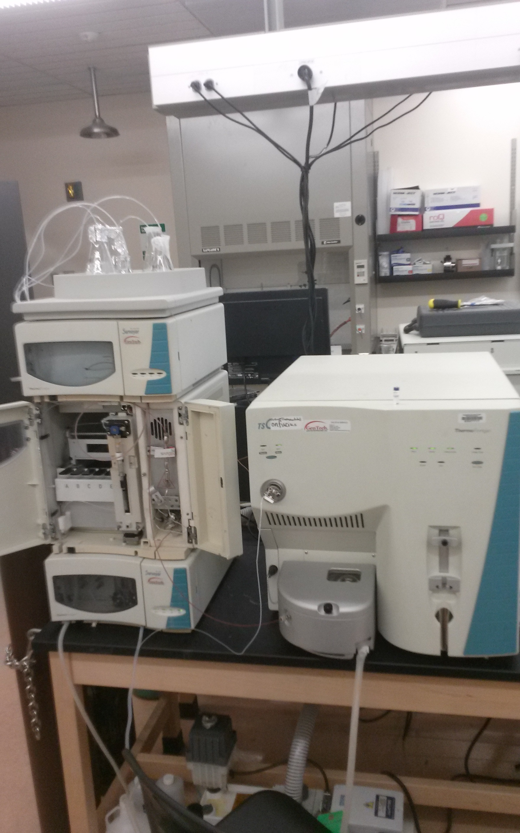
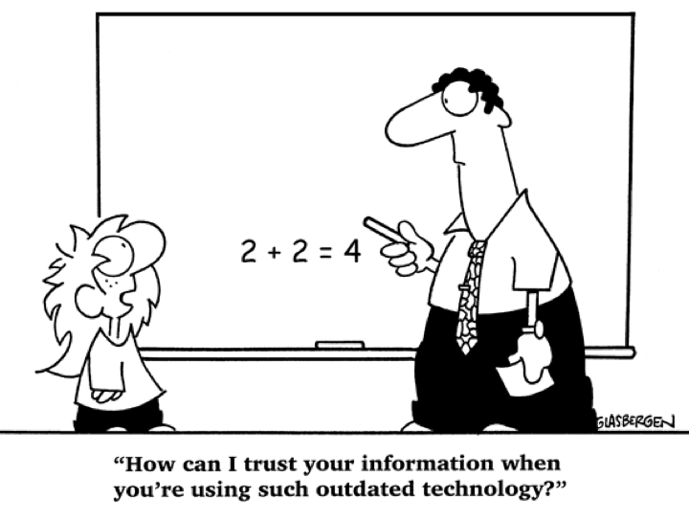


How do we get students to do “science”?
Instructor’s role
Pique interest
Provide tools/instruction
Provide support/confidence
Student’s role
Form hypothesis
Method optimization
-Capsaicin extraction
-HPLC analysis
Make mistakes
Revise hypothesis
Notes:
Grady

Slide 5
Transition from student to professional
Student Comment: “Descriptions of the lab from Standard Methods wasn’t really clear. It looked more like a reference for professionals than a guide for people performing it for the first time”
Structure of Individual Lab Activity
Desired Student Experience
Lab competence with a basic protocol
  Background information , self-training , and method development
Working in groups
  Practice or introductory activity to get their feet wet on the instrument
Troubleshooting experimental parameters
  Troubleshooting and method optimization
  Analysis of complex samples
Options to support differentiation/student voice
  Challenge question/application
These activities are difficult to achieve in a traditional three hour lab session, so we changed the format.

Slide 6
Modular inquiry-based lab activities
Activities contained self-guided and teacher-guided elements
Scaffolding toward more and more complex challenges.
Students worked at their own pace
  Built confidence with online tutorials
  Practice task management
Learning logistical problem solving
  Students shared a small instrumentation facility.
  Verifiable results: Labs center on abundant, well-characterized molecules.
Relevant inquiry: Provides experiences with messy data and an opportunity to troubleshoot and refine methods.
Multiple individual lab activities due at the end of the unit
Subject units that lasted for 3-4 weeks
Measurements and Statistics Unit
FT-IR Plastics Identification
Spectroscopy Unit
UV-Vis Protein Assay
Chromatography Unit
UV-Vis Peroxidase Analysis

Slide 7
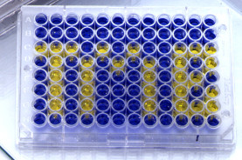
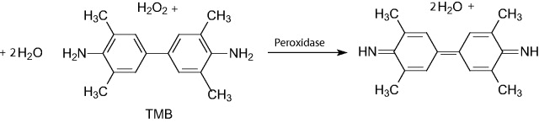
Basic idea
Students analyze molecular components of food by spectroscopic methods
1. HPLC with UV absorbance detection (capsaicin in peppers)
2. Colorimetric assay with chromogenic enzyme substrates (HRP).
Peroxidase activity assay
HPLC-UV analysis of capsaicinoids
capsaicin
dihydrocapsaicin
blue
yellow
Notes:
Grady

Slide 8
Capsaicin analysis
Extraction
Blended pepper (5g) + ethanol ~ 15 mL total. Cover/heat 30 min
Decant into 25 mL volumetric flask, dilute to mark with EtOH
Filter through 0.45 μm filter
Calibration
Students are given a 1 mg/mL capsaicin standard along with a rough LOD and LOQ that they must validate.
HPLC method
measure A_{280nm}
70
%B
A: H₂O (1% formic acid)
B: CH₃CN (1% formic acid)
30
3
10
12
minutes
Notes:
Grady

Slide 9
Data analysis
Capsaicin in peppers
y = 731390x – 23382
R² = 0.9998
Example of Student Calculation:
Thai chili pepper
3 replicates: average peak area: 4563530 standard deviation: 135581
4563530 = 731390x – 23382
x = 23,388 mg/mL
Notes:
Grady

Slide 10
Peroxidase analysis
Extraction
Blended horseradish (1.5g) + 300 mL H₂O
Mix/blend
Filter through Buchner funnel
Measuring peroxidase activity
Mix 1 mL extract, 2 mL cold dH₂O, 60 μL citrate buffer (pH 6.0) and 100 μL of 3% TMB in small test tube.
Transfer to cuvette and add 100 μL of 3% H₂O₂. Mix and record A_{650nm} every 30s.
Notes:
Grady with animations

Slide 11
Student work 1
According to google information for Thai Chili Scoville scale, it listed 50,000 – 100,000. The value gather from the lab is 50 times less. The Thai chili we have may be of a variety that is not real Thai pepper. Also, the peppers were not fully ripe yet. Subjective testing by biting into one is not considered very scientific since different people have different tolerance for spiciness.
Student work 2:
“The approximate concentration of the habanero extract was determined to be 0.026 g capsaicin per gram of habanero pepper. However, this concentration does not fall within the linear range of the calibration curve, meaning it may not be accurate. This experiment could have been improved by adding more points to the calibration curve, including a point for the undiluted standard solution (10 mg/mL). Another option would have been to further dilute the habanero extract so that it falls in the range of the calibration curve. Originally, the habanero extract was diluted to 1/100th of its original concentration. However, no peak for capsaicin appeared for this diluted sample on the chromatogram and so an undiluted sample was run.”
Notes:
Rick

Slide 12
Student evaluation of experiments
The following are items that students liked or learned from the lab activities:
Horseradish Peroxidase Spectroscopy
Capsaicin HPLC Analysis
“I felt like I could have kept messing around with different concentrations of potato, etc.”
“I learned how to do a water extraction and read a chromatogram”
“I learned how to create a standard curve”
“I learned that mace has no capsaicin”
“You must be very careful to maintain a blank and periodically calibrate the instrument”
“It was interesting to quantify how hot peppers were”
“I learned how to problem solve when the reaction was not proceeding correctly”
“I learned how to calculate a concentration from a calibration curve”
“Learning about enzymes in food”
“It was fun because we got to bring peppers we were curious about in to class [to analyze]”
“I learned how to adjust the reactants when the activity of an enzyme was too high to measure”

Slide 13
Student evaluation of experiments
The following are items that students disliked or from the lab activities:
Horseradish Peroxidase Spectroscopy
Capsaicin HPLC Analysis
“Trying to figure out how to properly use the UV-Vis”
“Trying to figure out how to do the dilutions for the calibration curve within a volume that would fit into the sample vial”
“Very sensitive machine required a standardizing blank before starting”
“The HPLC analysis takes long enough to run that we cannot see results returned in real time”
“It took us three tries to get workable (-ish?) data”
“Grinding took a long time”
“Time consuming!”
“More student members needed to bring materials in to compare”
“Procedure needed some modification”
Notes:
Rick

Slide 14
Future directions
Less is more
Need to be more clear with students about their goals and learning objectives
  It's not about getting the right answer, but understanding the answer they get and clearly communicating it
Use this model to develop modular labs for gen chem on down (incorporating inquiry starting with higher level classes)
Apply quantitative measures of assessment to measure effectiveness of instruction
Seek funding and ideas to promote development of new labs and access to greater number of students
Notes:
Melee, crazy fun, eye gouging

Slide 15
Just in case slide: HRP assay data
Notes:
Grady

Slide 16
Extra slide: References
Weaver, G. C., Russell, C. B., Wink, D. J. Inquiry-based and research-based laboratory pedagogies in undergraduate science. Nature Chem. Bio. 2008. 4, 577-580
Lack of quantitative measures of effectiveness in implementing inquiry into undergraduate education
Beck, C., Butler, A., da Silva K.B. Promoting Inquiry-Based Teaching in Laboratory Courses: Are We There Yet. CBE Life Sci Educ. 2014. 13, 444-452
Navigating the challenges of introducing inquiry based labs into science curricula: Student attitudes, instructor workload, funding.
Facayode, S. O. Guided-inquiry laboratory experiments in the analytical chemistry laboratory curriculum. Anal Bioanal Chem 2014. 406, 1267–1271.
Stimulate student interest in science careers and retention in upper level science courses
Kerr, M. Yan, F. Incorporating Course-Based Undergraduate Research Experiences into Analytical Chemistry Laboratory Curricula. J. Chem. Educ. ASAP.
Karukstis, K. K. Reinvigorating the Undergraduate Experience with a Research-Supportive Curriculum. J. Chem. Educ. 2004, 81 (7),938.
Tomasik, J. H., Cottone, K. E., Heethius, M. T., Mueller, A. Development and Preliminary Impacts of the Implementation of an Authentic Research-Based Experiment in General Chemistry. J. Chem. Educ., 2013, 90 (9), 1155–1161
Notes:
Grady

