Slide 1
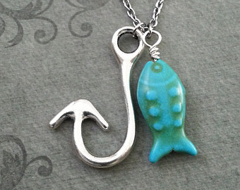
Food: How to Hook GOB Students’ Interest in Chemistry
Janice Gard, Lori Keeling, Deanna Ojennus
Elisabet Richardson, Karen Stevens, Jackson Wiley
Whitworth University
Spokane, WA

Slide 2
Uses of Food in Lecture and Lab
Lecture
House on a Hill
Egg Osmosis
Bagel Resonance
Food Coloring kinetic model
Double-stuff Oreo ketones
Ether bunny peeps
Laboratory Applications
Buccaneer Lab
Candy lab practical
Foods on Fire
Alka-Seltzer Kinetics
Strong-acids/weak acids
Buffers and Bones
Carbohydrates in Food
DNA or Protein?

Slide 3
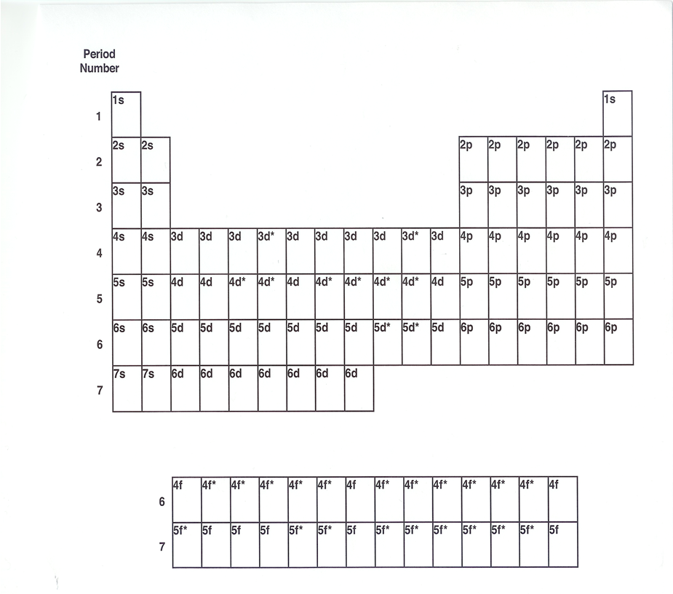
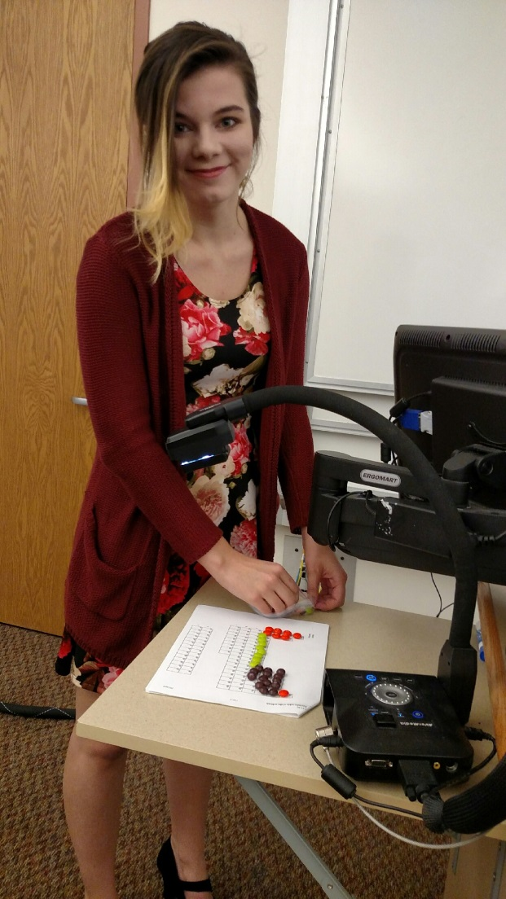
House on a Hill Analogy of Atomic Energy Levels
Adapted from ChemSource Version 2.0 1994. Atomic Structure.

Slide 4
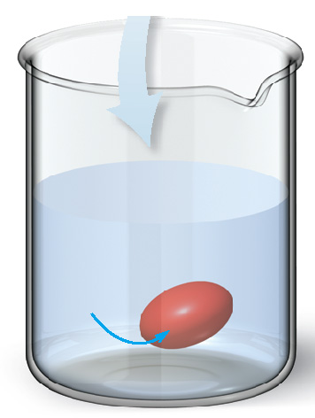
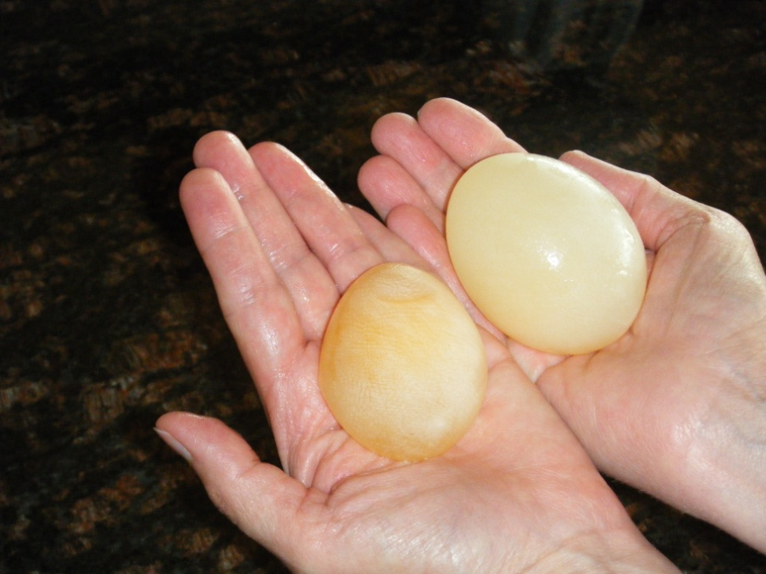
Let’s Review: Colligative Properties
Focus on the Human Body—Osmosis
A hypotonic solution has a lower osmotic pressure than body fluids.
Smith, J., General, Organic, and Biological Chemistry, 2nd ed.;
McGraw Hill: NY, 2012; pp 260-2.
hypotonic
solution
hypotonic
solution

Slide 5
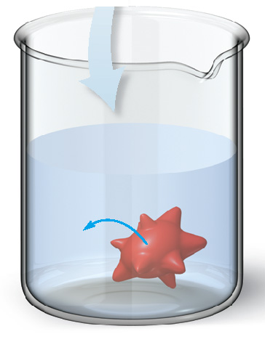
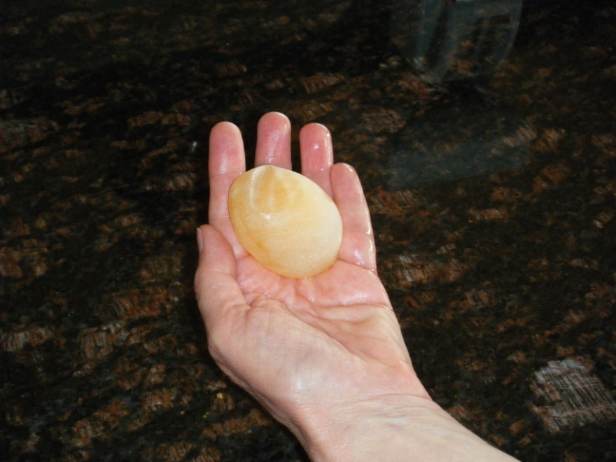
Colligative Properties
Focus on the Human Body—Osmosis
A hypertonic solution has a higher osmotic pressure
than body fluids.
hypertonic
solution
hypertonic
solution

Slide 6
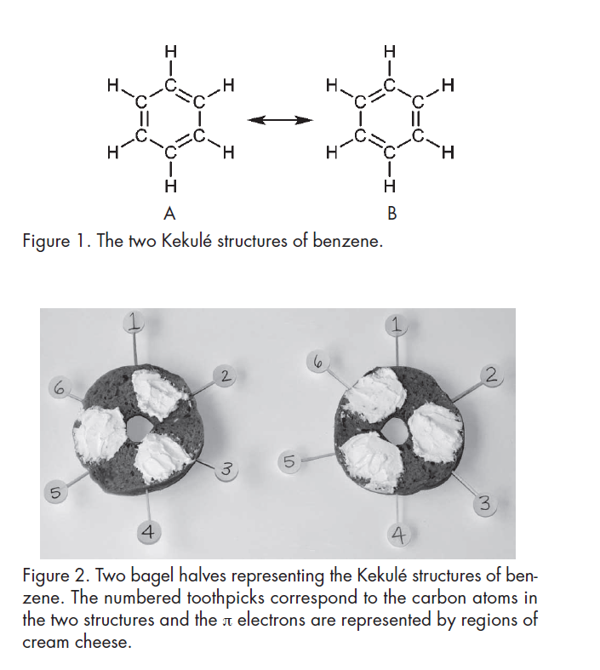
Bagel Resonance
Lin, S. Aromatic Bagels: An Edible Resonance Analogy. J. Chem. Ed. 2007, 84, 779-780.

Slide 7
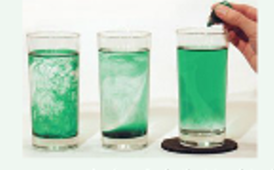
Food Coloring Model of Kinetics
The effect of temperature on diffusion (as a model of kinetics) can be seen by adding food coloring to water. A graduated cylinder of ice cold water, room temperature water, and hot water were allowed to sit so the water was still. Then one drop of food coloring was added to each. The drop sank/diffused down the entire cylinder at different rates, illustrating different rates with different temperatures.
Suchocki, J. Conceptual Chemistry, 5th ed; Pearson: Boston, 2014; p. 473.

Slide 8
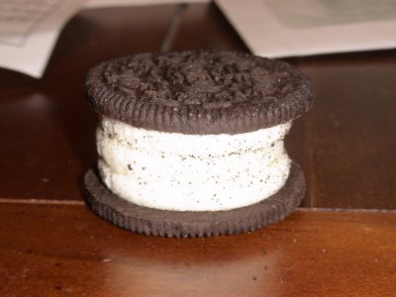
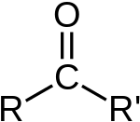
Double-Stuff Oreo Ketones and Aldehydes

Slide 9

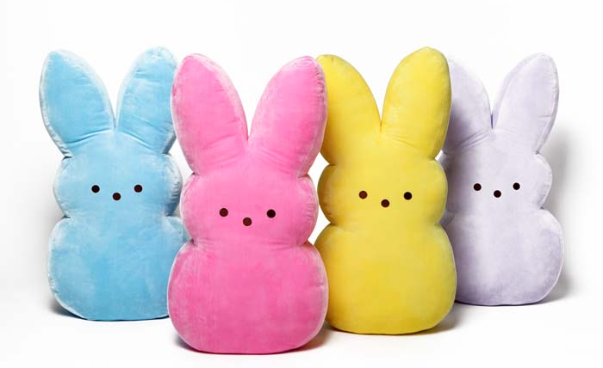
Ether Bunny Peeps

Slide 10
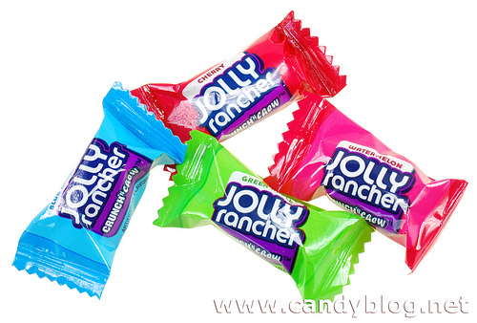
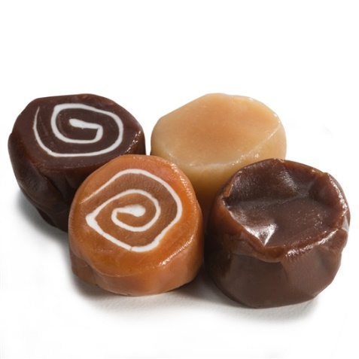
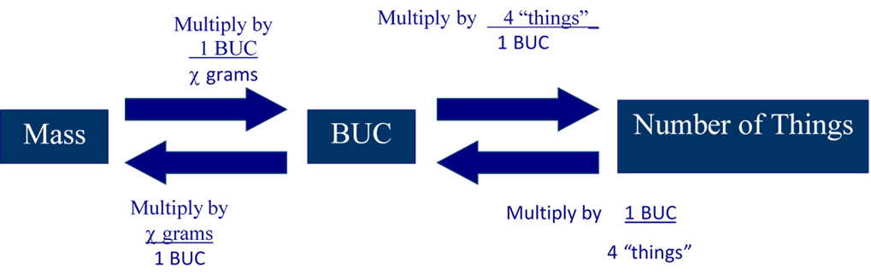
Buccaneer Lab
http://www.terrificscience.org/lessonpdfs/MoleIntro.pdf (accessed 9/19/16).
Flinn Scientific Inc. Mole Lab, publication 91622; 2012.

Slide 11
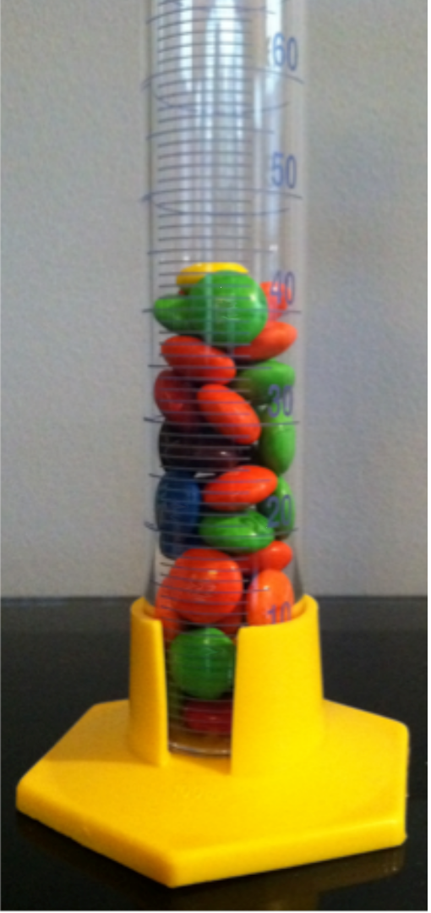
Dimensional Analysis/Conversion Factors with Candies
Ryan, S.; Wink, D.J. JCE Classroom Activity #112: Guessing the Number of Candies in the Jar- Who Needs Guessing?. J. Chem. Ed. 2012, 8, 1171-1173.

Slide 12
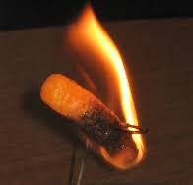
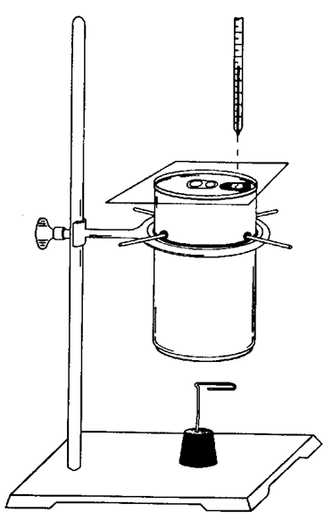
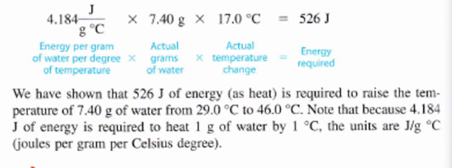
Foods on Fire
http://mgross2015.weebly.com/what-we-are-doing-in-science.html, (accessed 9/16/16)
Zumdahl, S. S. Introductory Chemistry, 4th ed.: Houghton Mifflin: Boston, 2000, pp. 71-75.
Smith, J., General, Organic, and Biological Chemistry, 3rd ed.; McGraw Hill: NY, 2016, pp. 743-6.

Slide 13
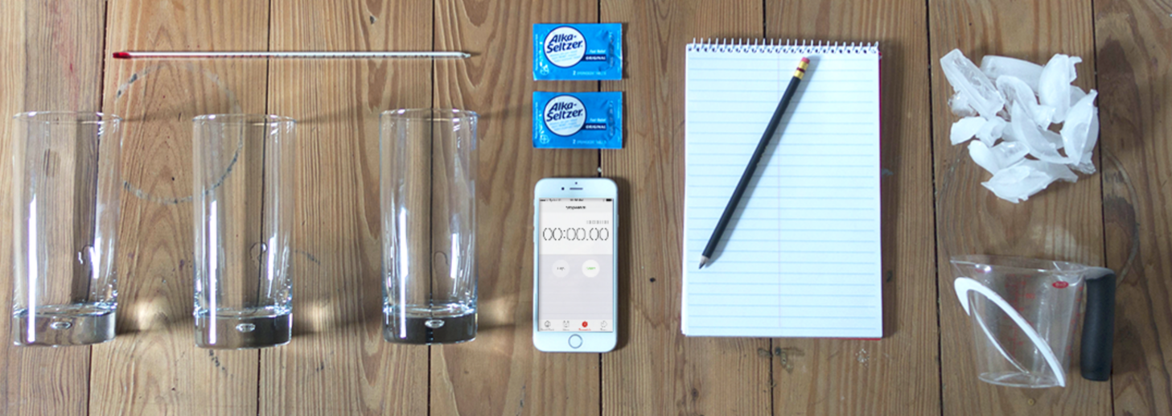
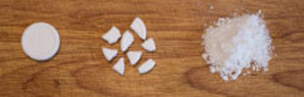
Alka Seltzer Kinetics
Katz, D. A. , An Introduction to Kinetics Using Alka Seltzer, http://www.chymist.com/AlkaSeltzer.pdf (accessed 9/15/16);
Bayer. Effect of Temperature on Rate of Reaction, https://www.alkaseltzer.com/science-experiments (accessed 9/15/16).
Bayer. Size vs Rate of Reaction, https://www.alkaseltzer.com/science-experiments (accessed 9/15/16).

Slide 14
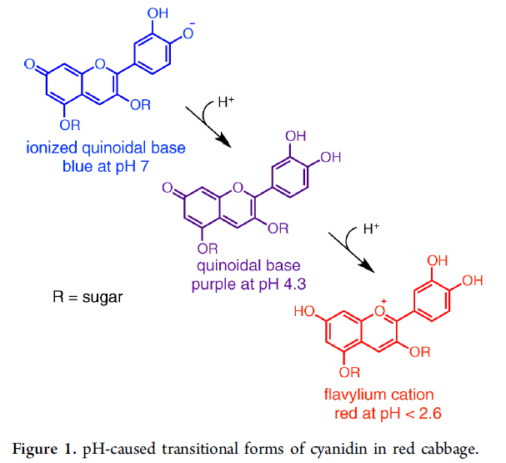
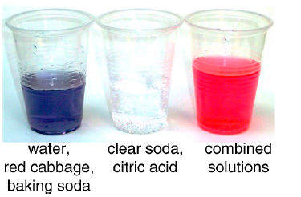
Strong acids-weak acids
  Applegate, C.; Neely, M.B. Sakuta, M. Laboratory Manual for General, Organic & Biological Chemistry; McGraw-Hill: New York; 2016: pp. 233-240.
  Stoddard, R.L.; McIndoe, J.S.; The Color-Changing Sports Drink: An Ingestible Demonstration. J. Chem. Ed. 2013, 90. 1032-1034.

Slide 15
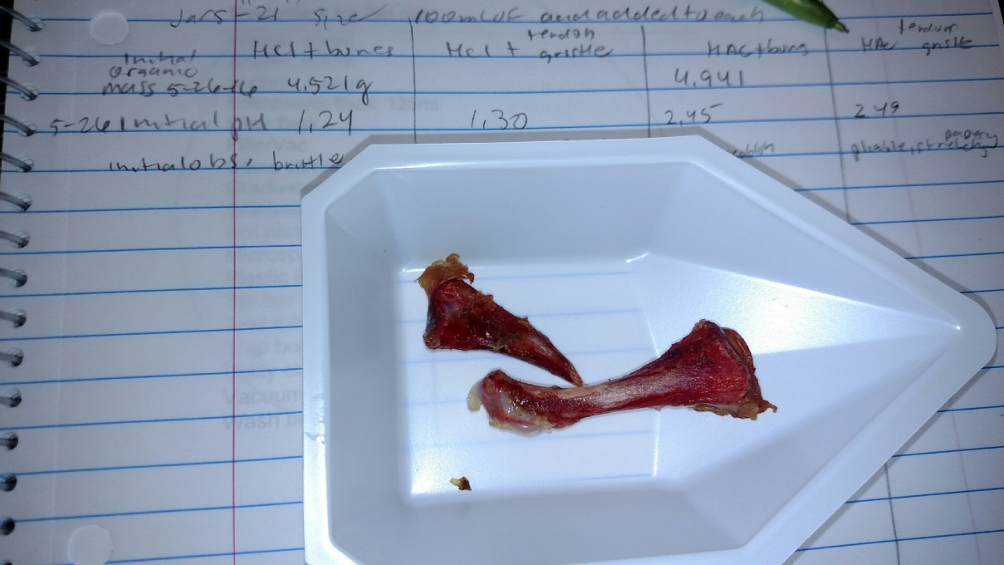
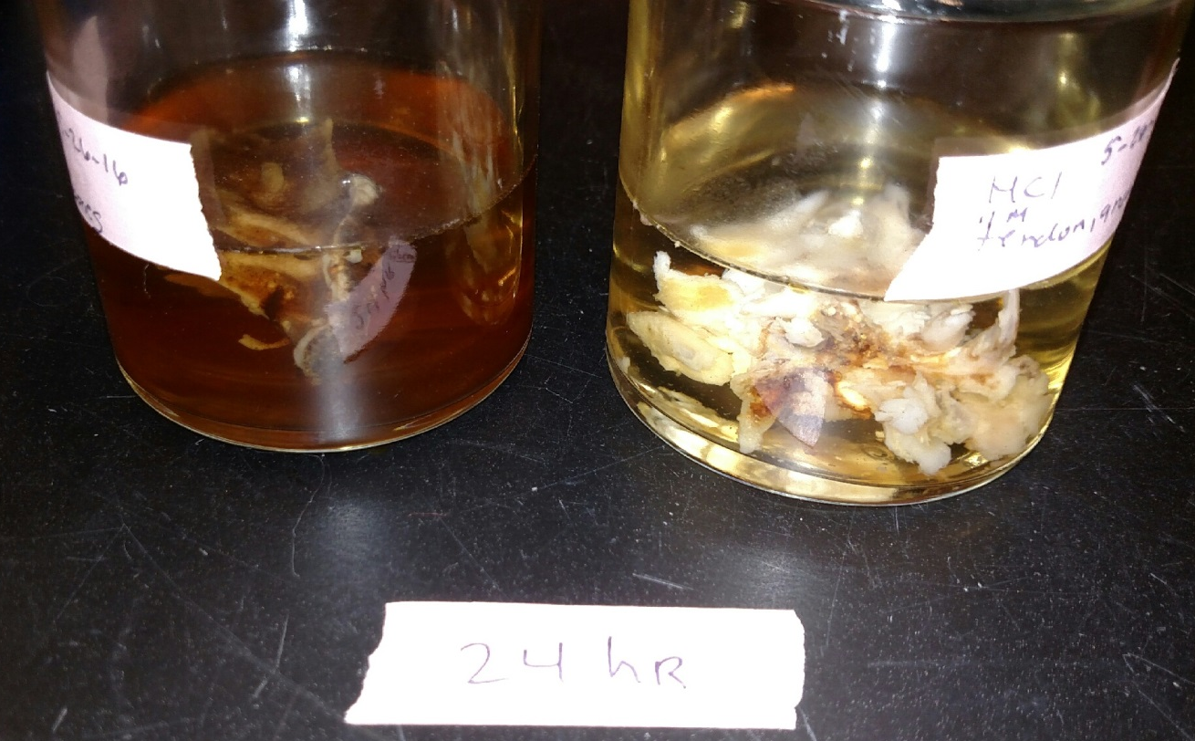
Buffers and Bones
1. Kelter, P.; Carr, J.; Scott, A. Laboratory Manual to Accompany Chemistry A World of Choices; McGraw Hill: Boston, 1999.
2. http://chemistry.olivet.edu/classes/chem100/pdf/Labs/Buffers%20Lab.PDF, (accessed 7-9-13).
3. Zumdahl, S.S., Chemistry, 4th ed.; Houghton Mifflin: Boston, 2000.
4. Smith, J., General, Organic, and Biological Chemistry, 2nd ed.; McGraw Hill: NY, 2012.
5. Krieger, P.A. A Visual Analogy Guide to Chemistry; Morton: Englewood (CO), 2012.
6. The DASH Project, Activity 5.3.16 Chemistry and Bones; University of Hawaii, DRDG, pp. 5.2.16-1-4.
7. Applegate, C.; Neely, M.B. Sakuta, M. Laboratory Manual for General, Organic & Biological Chemistry; McGraw-Hill: New York; 2016: pp. 233-240.
8. Henrickson, C.H.; Byrd,L.C.; Hunter, N.W. A Laboratory Manual for General, Organic, and Biochemistry; McGraw-Hill; New York; 2011: pp. 229-243.
9. Anthony, S.; Braun, K.L.; Mernitz, H. ChemConnections Activity Workbook; Norton: New York; 2013: pp. 253-260.

Slide 16
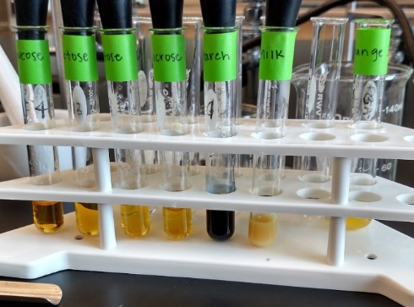
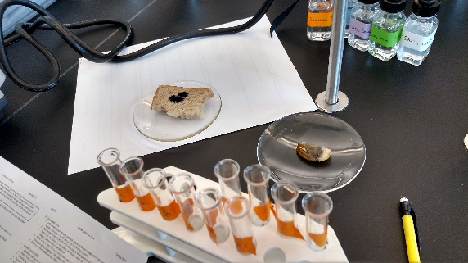
Carbohydrates in Food
Used courtesy of Smith, J., General, Organic, and Biological Chemistry, 2nd ed.; McGraw Hill: NY, 2012.

Slide 17
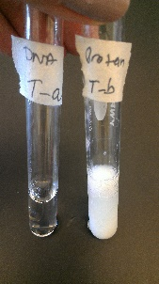
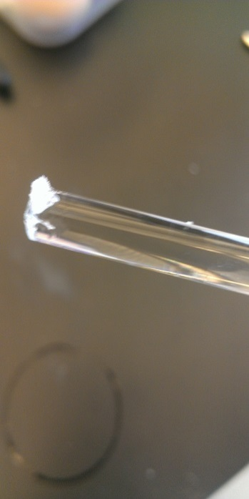
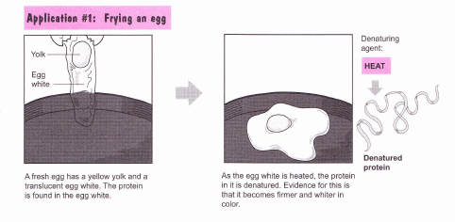
DNA or Protein?
Krieger, P.A., A Visual Analogy Guide to Chemistry; Morton: Englewood (CO), 2012.
Valentin, D.; Pulido-Cordoba, L.; Chavez-Reyes, A. An Easy Way to Distinguish DNA from Protein: An Experiment for General Chemistry. Journal of Chemical Education. 2012, 89, 1333-1335.

Slide 18
Citations
ChemSource Version 2.0 1994. Atomic Structure.
Smith, J., General, Organic, and Biological Chemistry, 2nd ed.; McGraw Hill: NY, 2012; pp 260-2.
Lin, S. Aromatic Bagels: An Edible Resonance Analogy. J. Chem. Ed. 2007, 84, 779-780.
Suchocki, J. Conceptual Chemistry, 5th ed; Pearson: Boston, 2014; p. 473.
http://www.terrificscience.org/lessonpdfs/MoleIntro.pdf (accessed 9/19/16).
Flinn Scientific Inc. Mole Lab, publication 91622; 2012.

Slide 19
Citations
Ryan, S.; Wink, D.J. JCE Classroom Activity #112: Guessing the Number of Candies in the Jar- Who Needs Guessing?. J. Chem. Ed. 2012, 8, 1171-1173.
http://mgross2015.weebly.com/what-we-are-doing-in-science.html, (accessed 9/16/16).
Zumdahl, S. S. Introductory Chemistry, 4th ed.: Houghton Mifflin: Boston, 2000, pp. 71-75.
Smith, J., General, Organic, and Biological Chemistry, 3rd ed.; McGraw Hill: NY, 2016, pp. 743-6.
Katz, D. A. , An Introduction to Kinetics Using Alka Seltzer, http://www.chymist.com/AlkaSeltzer.pdf (accessed 9/15/16);

Slide 20
Citations
Bayer. Effect of Temperature on Rate of Reaction, https://www.alkaseltzer.com/science-experiments (accessed 9/15/16).
Bayer. Size vs Rate of Reaction, https://www.alkaseltzer.com/science-experiments (accessed 9/15/16).
Applegate, C.; Neely, M.B. Sakuta, M. Laboratory Manual for General, Organic & Biological Chemistry; McGraw-Hill: New York; 2016: pp. 233-240.
Stoddard, R.L.; McIndoe, J.S.; The Color-Changing Sports Drink: An Ingestible Demonstration. J. Chem. Ed. 2013, 90. 1032-1034.
Kelter, P.; Carr, J.; Scott, A. Laboratory Manual to Accompany Chemistry A World of Choices; McGraw Hill: Boston, 1999.

Slide 21
Citations
http://chemistry.olivet.edu/classes/chem100/pdf/Labs/Buffers%20Lab.PDF, (accessed 7-9-13).
Zumdahl, S.S., Chemistry, 4th ed.; Houghton Mifflin: Boston, 2000.
Smith, J., General, Organic, and Biological Chemistry, 2nd ed.; McGraw Hill: NY, 2012.
Krieger, P.A. A Visual Analogy Guide to Chemistry; Morton: Englewood (CO), 2012.
The DASH Project, Activity 5.3.16 Chemistry and Bones; University of Hawaii, DRDG, pp. 5.2.16-1-4.
Applegate, C.; Neely, M.B. Sakuta, M. Laboratory Manual
for General, Organic & Biological Chemistry; McGraw-Hill:
New York; 2016: pp. 233-240.

Slide 22
Citations
Henrickson, C.H.; Byrd,L.C.; Hunter, N.W. A Laboratory Manual for General, Organic, and Biochemistry; McGraw-Hill; New York; 2011: pp. 229-243.
Anthony, S.; Braun, K.L.; Mernitz, H. ChemConnections Activity Workbook; Norton: New York; 2013: pp. 253-260.
Valentin, D.; Pulido-Cordoba, L.; Chavez-Reyes, A. An Easy Way to Distinguish DNA from Protein: An Experiment for General Chemistry. Journal of Chemical Education. 2012, 89, 1333-1335.

