Slide 1
Using OneNote in the Classroom
Jeffrey Engle
Tacoma Community College

Slide 2
Student Lecture Preference
Students were asked whether they prefer PowerPoint lectures or “Chalk-Talks”
Students saw negative aspects to both teaching styles, but saw more negatives aspects with PowerPoint
Students express a strong preference for recorded lectures
Notes:
Surveyed Students for the Past two years regarding teaching styles. Approximately 100 students surveyed.

Slide 3
Student Lecture Preference
Notes:
Students were asked to explain what they don’t like about each teaching style

Slide 4
Common Student Views on PowerPoint
Common Student Complains about PowerPoint:
“My instructors go to fast when they use it”
“PowerPoint is boring”
“I learn better when I get a chance to follow along on the board”
“I have a hard time knowing what to take notes on”
http://www.timtim.com/article/detail/id/58/sortby/date

Slide 5
Common Student Views on “Chalk-Talks”
Common Student Complains about “Chalk-talks”:
“The instructor faces the board/blocks the board”
“The board can be hard to see”
“Once you erase something it is gone”
No (good) way to record lecture

Slide 6
Ideal Compromise
Good Aspects of PowerPoint Lectures
Can incorporate media
Can be recorded using screen capture software
Can be viewed after lecture is over
Can be turned into a “fill in the blank” activity
Good Aspects of “Chalk Talks”
Instructors can demonstrate concepts such as arrow pushing
Encourages students to engage in note taking, not “note copying”
Examples/questions can be made on the fly
OneNote!

Slide 7
What is OneNote?
Free program/app offered by Microsoft
Works on every platform (Mac/iOS/PC/Android/Web Browser)
Acts as an electronic 3-ringed binder
Ability to store documents or handwritten notes
Option to incorporate media such as audio or video
Notes:
Demo Cyclohexane Page

Slide 8
OneNote Features
Everything is saved/synced automatically
Notebooks can be shared publicly/privately
Read-only
Edit Permission
Handwriting recognition/search
Integrates with learning management software
Can be recorded!

Slide 9
DIY “Khan Academy” Style Videos
Notes:
Flip Classes
Record regular lectures
Record Review Sessions
Students watch them at home on double speed to review
Some students don’t take notes during lecture, but do at home

Slide 10
Plug for Youtube (vs other options)
Free and easy
Can be played on practically any device
Unlimited storage
No log-on required for students!
Notes:
Panopto
Camtasia
Open Broadcaster Studio (free)
For my class I get approx. 2000 min/week of views---That is equivalent to an extra day of lecture every week
Students do not like videos posted on Canvas!

Slide 11
OneNote Class Notebook Add-In
Built for institutions that use Office 365
Uses institutional log-in
OneNote normally requires a Hotmail/Outlook email address
Works in OneNote 2013/2016
Onenote.com/classnotebook
Notes:
Professional Development on the Toolbar- Instructional Videos

Slide 13
How to use the Class Notebook Add-in
Download the Add-In at: Onenote.com/classnotebook

Slide 14
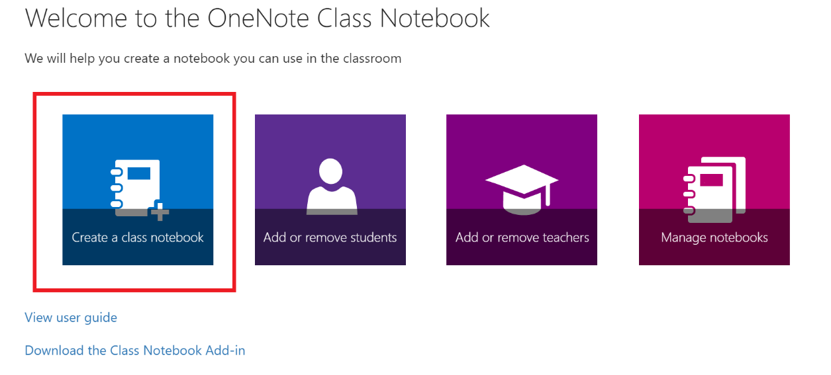
Class Notebook

Slide 15
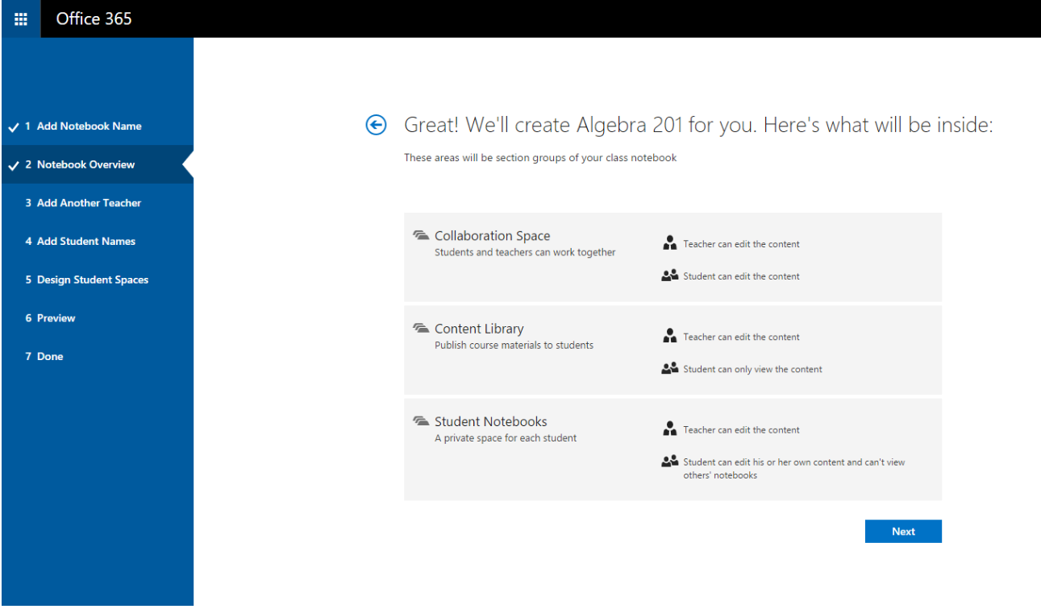

Slide 16
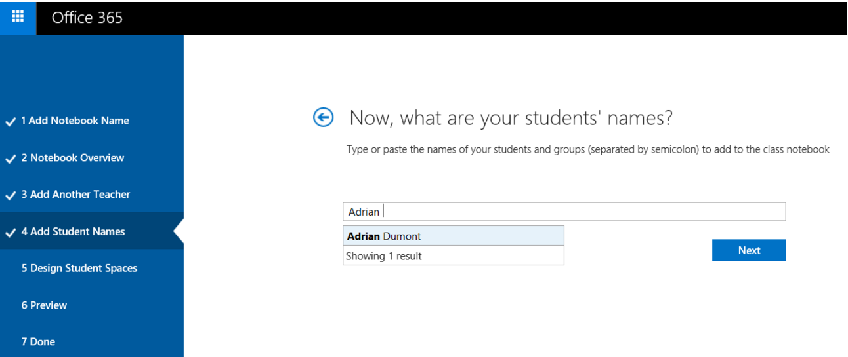
Class Notebook

Slide 17
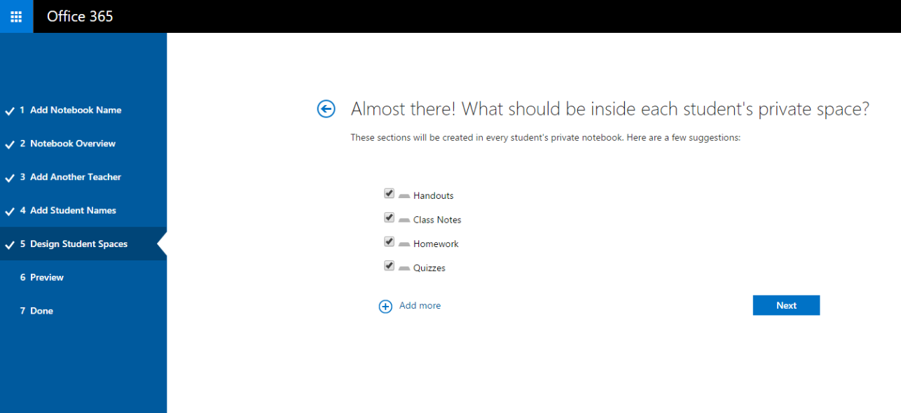
Class Notebook

Slide 18
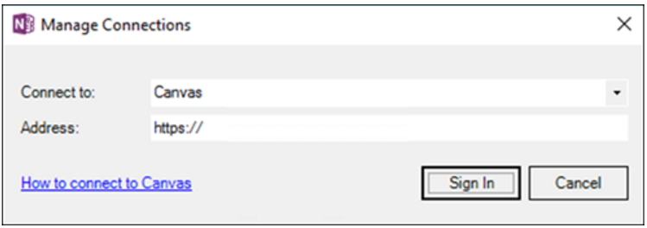
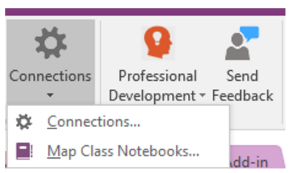
Class Notebook LMS Features

Slide 19
Class Notebook LMS Features

Slide 20
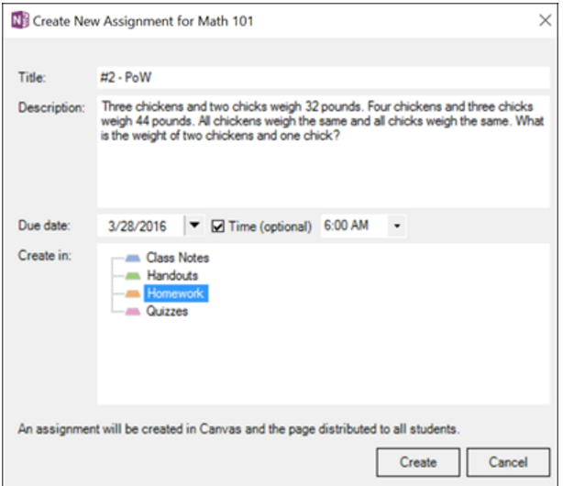
Class Notebook LMS Features

Slide 21
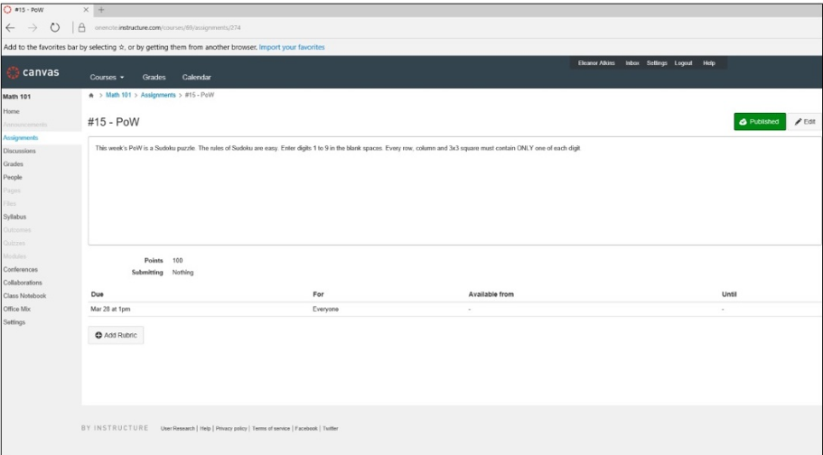
Class Notebook LMS Features

Slide 22
Class Notebook LMS Features

Slide 24
Conclusions (Personal Experience)
Don’t be afraid of trying something new
Students are surprisingly forgiving with technical issues (just be honest with them)
The best way to learn OneNote:
Make your own personal notebook
Make a notebook for your lecture
Learn to share notebooks
Try the Class Notebook Add-in

Slide 25
Questions?

